Slide 1

CRVS and Health Information System & eHealth in Thailand & AeHIN
The importance of CRVS to eradicate poverty panel discussion
30 March 2017
United Nation Conference Center, Bangkok
Boonchai Kijsanayotin MD., PhD.(Health Informatics)
AeHIN Chair
Health Information Standards Development Center (THIS)
Ministry of Public Health, Thailand

Slide 2


Key Questions
In which ways are civil registration supporting service delivery in countries?
What can be done to ensure hard to reach and marginalized groups are included in CRVS systems?
Why is improving CRVS so essential to the 2030 Agenda for Sustainable Development and the achievement of the SDGs?
https://www.unicef.org/health/files/Better_Data_for_Women_and_Children_Final_Meeting_Report_(Mar_2017).pdf

Slide 3
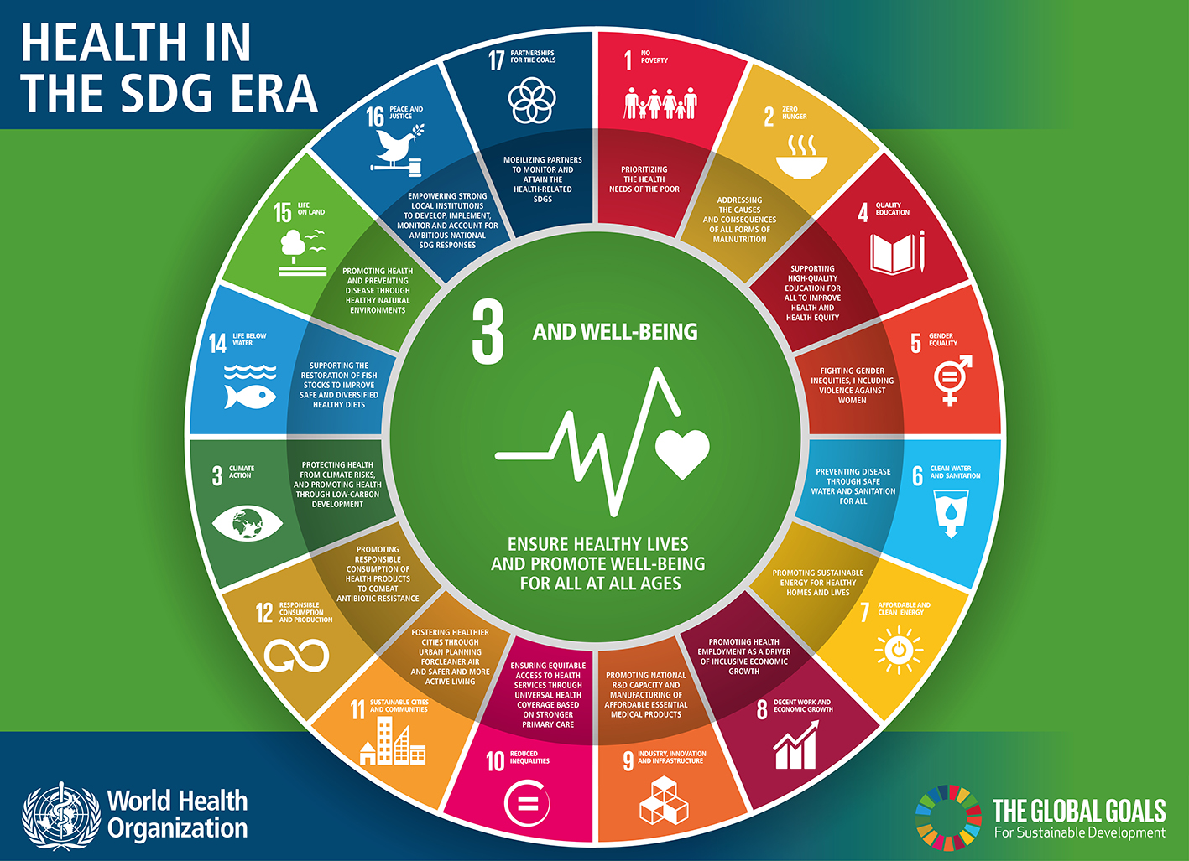
The 17 Sustainable Development Goals
169 targets
Poverty
Food security and nutrition
Health
Education
Gender equality
Water and sanitation
Energy
Economic growth and employment
Infrastructure, industrialization, innovation
Equity
Cities
Consumption and production
Climate change
Oceans, seas and marine resources
Ecosystems
Peaceful and inclusive societies
Means of implementation
Red: risk factors with direct effect on health
Determinants: with indirect effect on health

Slide 4
Thai Vital Statistics after 1996
BORA
Ministry of Interior
Central Registry
Ministry of Public Health
Compile, code, validate and process statistics
Electronic files
Printed/ Web Vital statistics report
Web entry Birth certificate
(Start 2010)
Report statistics back to provinces
Data Sync.
Web entry death certificates (start 2006)
National Health Security
Office (NHSO)
Provincial Health offices
Hospitals

Slide 5
Merits of civil registration to the vital statistics system and healthcare system and vis versa
:Thailand Example
To create birth and mortality statistical data used to implement public health policies
  Timeliness , increase quality of data & statistics
To support the benefits related to health care and social security systems.
  Universal health care system: beneficiary roster
  Disease management program: HIV/AIDS
To develop policies and plans to decrease mortality rate of population

Slide 6
Lessons learnt from CRVS development in Thailand
Long-term development of CRVS with some degree of political support and commitment → high coverage of birth and death registration
CRVS is the backbone for health system : planning policy, monitoring progress of health system development, and the impact of health policies in Thailand,
Challenges of CRVS:
  under-reporting of maternal mortality
  ill-defined and unknown causes of death

Slide 7
AeHIN 4 Strategic Area
Build capacity for eHealth, Health Information Systems, and Civil Registration and Vital Statistics (CRVS)
Increase peer assistance and knowledge exchange and sharing through effective networking
Promote standards and interoperability within and across countries
Enhance leadership and sustainable governance, and monitoring and evaluation

Slide 8


Asia eHealth Information Network (AeHIN)
AeHIN was created by WHO in 2011 to assist countries with their national HIS & eHealth development.
Our members are composed of senior officers from Ministries of Health, Ministries of ICT, government health insurance agencies, academe, non-government sectors and development agencies.
Started out as seven individuals from six countries struggling to solve the interoperability problem. Now we have grown to more than 950 from 57 countries.
www.AeHIN.org
www.digitalhealthap.com

Slide 9
CRVS and Health Interoperability and
Data Exchange Architecture
From: Edward Duffus’ presentation ; CRVS Digitisation and the linkage with National Identity

