Slide 1
Introduction to the Regional Action Framework (RAF) Reporting Mechanism and Review Process
4th Meeting of the Regional Steering Group
David Rausis, 13.11.2018

Slide 2

2014 Ministerial Conference on CRVS
  A Shared Vision
  “By 2024, all people in Asia and the Pacific benefit from universal and responsive CRVS systems that facilitate the realization of their rights and support good governance, health and development”
Notes:
Unfortunately, many countries in Asia and the Pacific do not have universal and responsive CRVS systems hampering inclusive and sustainable development in the region and progress towards achieving internationally agreed development goals such as the SDGs.
In response, governments and development partners in the region have come together to concentrate and accelerating efforts to improve CRVS systems in the region. This work culminated into the Ministerial Conference on CRVS in Asia and the Pacific, held in November 2014 in Bangkok, Thailand.
During this Ministerial Conference, governments in this region:
- Shared a vision that: “By 2024, all people in Asia and the Pacific benefit from universal and responsive CRVS systems that facilitate the realization of their rights and support good governance, health and development” [Same as presentation text]

Slide 3


2014 Ministerial Conference on CRVS
  To realize this shared vision, Asia-Pacific governments:
  Adopted the Ministerial Declaration to “Get every one in the picture”
  Proclaimed the Asian and Pacific CRVS Decade, 2015-2024
  Developed the Regional Action Framework
    3 goals
    15 nationally set targets
    7 action areas
    8 implementation steps
Notes:
To achieve this vision, governments committed to improving their national CRVS systems by :
Proclaiming the Asian and Pacific CRVS Decade, 2015-2024 as a timeframe to accelerate efforts and achieve this vision
Developing the Regional Action Framework to support the improvement of civil registration and vital statistics (CRVS) systems.
The Regional Action Framework serves as a catalyst for Governments and development partners to focus and accelerate their efforts to realize the shared vision.
Specifically, it contains:
3 goals including universal civil registration and legal documentation as well as accurate, complete and timely vital statistics.
15 targets set by the countries to reflect the national context and aspirations.
7 action areas to guide the concerted efforts by all relevant stakeholders.
8 implementation steps to required to implement the RAF.

Slide 4



Regional Action Framework:
Goals
 | Goal 1 Universal civil registration of births, deaths and other vital events
 | Goal 2 All individuals are provided with legal documentation of civil registration of births, deaths and other vital events, as necessary, to claim identity, civil status and ensuing rights
 | Goal 3 Accurate, complete and timely vital statistics (including causes of death) are produced based on registration records and are disseminated
Notes:
The goals recognize core human rights principles of progressive realization, non-regression, non-discrimination and equity, which apply to all countries and areas.
Goal 1 is an expression of the internationally accepted principle of the universal coverage of civil registration, including birth registration. The CRVS system should register all vital events occurring in the territory and jurisdiction of the country or area, including among hard-to-reach and marginalized populations, regardless of citizenship status.
Goal 2 reflects that CRVS systems provide legal documentation of civil registration to individuals and families for legal and administrative purposes. Legal documentation, including notably birth certificates, is strongly linked with a broad range of rights and activities, in particular legal identity. This goal addresses the distinction between the civil registration of a vital event and the possession of formal proof that it took place, in the form of legal documentation.
Goal 3 highlights the critical importance of civil registration being linked to the production and quality assurance of vital statistics on the occurrence and characteristics of vital events.
https://www.getinthepicture.org/regional-action-framework

Slide 5
Regional Action Framework:
Action Areas
Political Commitment
Public engagement, participation and generating demand
Coordination
Policies, legislation and implementation of regulations
Infrastructure and resources
Operational procedures, practices and innovations
Production, dissemination and use of vital statistics
Notes:
The action areas serve as a basis for Governments and development partners to focus and organize efforts towards developing, implementing and supporting comprehensive multisectoral national CRVS strategies, including delineating the responsibilities of involved stakeholders.
Political Commitment e.g., Issuing a high-level declaration on the importance of CRVS for all individuals
Public engagement, participation and generating demand e.g., Undertaking national campaigns or drives to encourage individuals and families to declare and register vital events
Coordination e.g., Establishing a representative and functioning multisectoral mechanism responsible for CRVS coordination, such as a national committee or board
Policies, legislation and implementation of regulations e.g., Ensuring uniform implementation of regulations across the jurisdiction
Infrastructure and resources e.g., Allocating adequate national financial resources for the implementation of national comprehensive CRVS strategies
Operational procedures, practices and innovations e.g., Reviewing and adapting registration forms and procedures to align with international standards for legal and statistical purposes;
Production, dissemination and use of vital statistics e.g., Providing ongoing training for statisticians in the production, dissemination and analysis of vital statistics

Slide 6
Regional Action Framework:
Implementation Steps
Establish national CRVS coordination mechanism
Conduct a comprehensive assessment
Set the national target value for each target
Assess inequalities related to CRVS experienced by subgroups of the population, and, where appropriate, set national targets to address those inequalities
Develop a comprehensive multi-sectoral national CRVS strategy
Develop and implement a plan for monitoring achievement of the national targets
Assign a national focal point (NFP) within the Government
Report relevant information to the ESCAP secretariat
Notes:
Setting and achieving these goals and targets requires a step by step approach. The 8 Implementation Steps serves as template and guide for this process.
I would like to take this opportunity to highlight that a well functioning national coordination mechanism and a solid national strategy for improving CRVS is critical to not only implementing the RAF but ensuring that improvements are sustainable and have a broad, long lasting positive impact.
https://www.getinthepicture.org/implementation-steps

Slide 7
Regional Action Framework:
Regional Support
Regional Steering Group
  Consist of countries and development partners
  Oversight and guidance for implementation of the Regional Action Framework
  Taskforces to provide support
CRVS Partnership
  Development partners
  Discuss and coordinate partners’ activities to avoid replication
  Standardize partners’ message about the CRVS decade
Notes:
As you can see the RAF in quite comprehensive and take significant effort to implement. In order to support countries, there are two main bodies that can help countries in the region achieve the goals and targets as well as the implementation steps.
RSG
-Bangladesh, Bhutan, India and Pakistan are members of the RSG
Partnership
-UN agencies including UNICEF, UNESCAP, WHO, UNFPA, UNHCR among others. Other partners including Bloomberg Data for Health, Plan International, World Visions, etc.
-Coordinate partnership activities for concerted efforts and to avoid replication of work

Slide 8
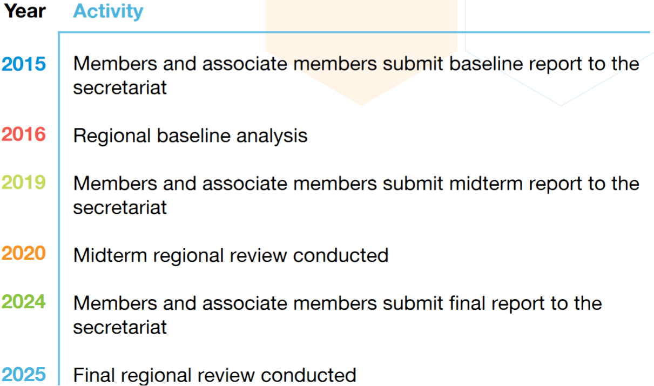
Reporting Mechanism - Timeline
Notes:
As said in the opening, we are at a critical moment in the preparation of the Midterm review that will be conducted at the ministerial level in 2020.
Next year members and associate members will need to submit a midterm report to ESCAP (secretariat). We will discuss it in the next session.
In order to make informed decisions on the midterm report, it is important to remember what happened in the baseline report.

Slide 9
Baseline Recap – Targets
38/62 baseline reports recieved
Goal 1
  1.A Percentage of births that are registered within one year - 35
  1.B Children under 5 have their birth registered - 33
  1.C People living in the country have their birth registered - 33
  1.D Deaths are registered within one year of the event - 35
  1.E Deaths recorded have a medically certified CoD - 32
Goal 2
  2.A Birth certificates are issued for the registered births - 33
  2.B Death certificates, with underlying cause of death, are issued for the registered deaths - 34
Notes:
Number of countries that set targets emboldened
Questionnaire sent to 53 Member States and 9 Associate Member States.

Slide 10
Baseline Recap – Targets
Goal 3
  3.A Annual nationally representative statistics on births - 31
  3.B Annual nationally representative statistics on deaths - 34
  3.C Deaths in health facilities or with the attention of a medical practitioner have an underlying cause of death code - 33
  3.D Reduction of Ill-defined codes - 28
  3.E Deaths outside of a health facility and without the attention of a medical practitioner have their underlying cause of death code determined through verbal autopsy – 26
  3.F Key summary tabulations of vital statistics on births and deaths using registration records - 31
  3.G Key summary tabulations of vital statistics on causes of death using registration records - 31
  3.H Cital statistics report for the previous two years, using registration records - 31
Notes:
Number of countries that set targets emboldened
Slightly less countries set targets for goal 3. Could be because goal 3 is heavily influenced by whether countries are successful with goal 1 and 2.

Slide 11
Challenges
Partial responses
Targets without baseline
Lack of consistency
Unclear sources and years
Validation takes time
Late submissions

Slide 12
Key Lessons
Questionnaires filled by a committee/group are of better quality
Webinar and Q&A sheet seemed helpful
Pilot testing would have helped identify many problems
Notes:
38 countries with coordination mechanisms
Workshops?
It would be good if we could get a few countries to pilot the questionnaire

Slide 13
Thank you!
For more information, please visit: www.getinthepicture.org

