Slide 1




Improving access to registration for hard to reach population:
Online Birth Registration System for Non-Thai
Session 3 : Current CRVS Issues
At the Fourth Meeting of the Regional Steering Group for CRVS in Asia and the Pacific
11:00 - 10:15, 14 November 2018
United Union Conference Center (UNCC), Bangkok
Boonchai Kijsanayotin MD. Ph.D.(Health Informatics)
Manager: Thai Health Information Standards Development Center (THIS)
Health Systems Research Institute (HSRI), Ministry of Public Health Thailand
Chair: Asia eHealth Information Network (AeHIN)

Slide 2
Thailand Healthcare Systems
Located at the center of the Indochina Peninsula
Government (current): Unitary parliamentary constitutional monarchy under a military junta
One of the few middle-income countries successfully achieving universal coverage
Three major public health insurance schemes
80% of hospitals are public Hospitals

Slide 3
Integrated Civil Registration (CR) and National ID systems
is the Foundation for the success of
Universal Health Coverage (UHC), Healthcare Delivery and Social Welfare

Slide 4
Civil registration is the continuous, permanent, compulsory and universal recording of the occurrence and characteristics of vital events pertaining to the population as provided through decree or regulation in accordance with the legal requirements of a country.
National ID is used by the governments of many countries as a means of tracking their citizens, permanent residents, and temporary residents for the purposes of work, taxation, government benefits, health care, and other governmentally-related functions.

Slide 5
Civil registration and online birth e-registration systems
All Data entered
in DB.
60+ Million Records
New ID-3 type
ID Card
Smart ID Card
Civil Registration law Reform: All births register
Citizen ID Number
1982
1983
1988
1996
1997
2001
2003
2005
2008
2010
13 Digit Design
VS linked with CR system
UHC Implementation
Completed
Online CR Nationwide
Role Out,
Online birth registration system

Slide 6


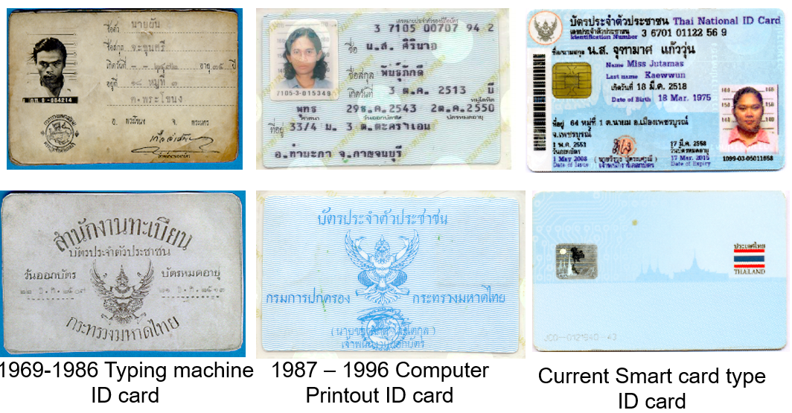

Thai Civil Registration Systems
Bureau Of Registration Administration (BORA) Ministry of Interior started computerized population database and Citizen ID project in 1982
BORA operates and maintains the data base for the entire population of the country, and issues identity cards and household booklets
Notes:
Two outcome documents from the Ministerial Conference:
A Ministerial Declaration to ‘Get Every One In The Picture’
A Regional Action Framework for the Decade, which contains 3 goals that you can see on the bottom right
Universal civil registration (blue icon)
All individuals are provided with legal documents to claim identity and ensuing rights (red icon)
Accurate, complete and timely vital statistics (green icon)
The Regional Action Framework have 7 areas of action, and under each of the goals a framework of targets that each country would set individually, for example by 2024, 99% of births shall be registered and 80% of deaths shall be registered.

Slide 7
Contribution of National ID system and IT infrastructure
to Thailand UHC implementation
HIS & HIT context
1. Computerized Civil Registration & Citizen IDs
2. Providers’ ICT adoption & country’s ICT infrastructure
3. Administrative data standards, coding standards & DRG technology
Universal Coverage Scheme Implementation

Slide 8
UHC Scheme Beneficiaries Roster
complete in one year
NHSO
National Health Security Office
Bureau Of Registration
Administration (BORA)

Slide 9
Citizen Identification Number
  Citizen ID issues at the of birth registration
  Called 13 Digits number
  The number is needed when transact with government and many non government agencies:
    getting free healthcare services
    enrolling children to free education
    asking for bank account.

Slide 10
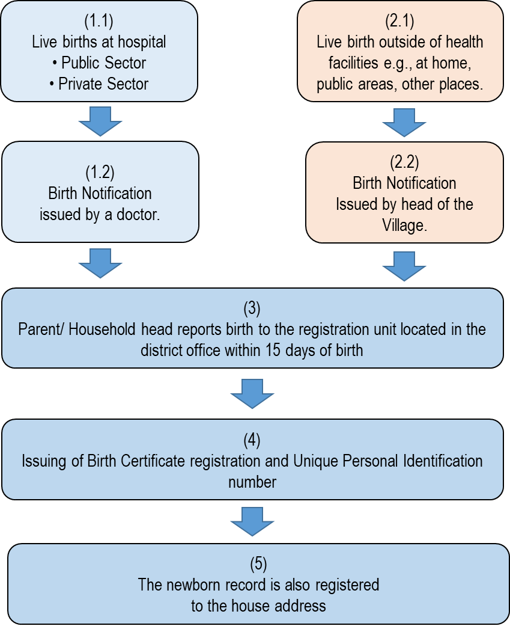
Birth registration process and issuance of unique personal identification number at birth

Slide 11
A birth certificate is the first identity document that proves the baby identity indicated that she/he is exist in this world.
Birth certificate facilitates access to essential services, such as health care, social services, and education.

Slide 12
Birth registration challenges
~ 7% (40,000-50,000 life births) not register (before 2011)
~ 20% in area where registered and unregistered migrant workers and other unregistered non-Thai residents
Misunderstand birth notification document is birth certificate
Live far from the registration offices
Don’t need to use birth certificate

Slide 13
Civil Registration & Vital Statistics Linkage since 1996
and Online birth registration since 2009
BORA
Ministry of Interior
Central Registry
Ministry of Public Health
Compile, code, validate and process statistics
Electronic files
Printed/ Web Vital statistics report
Report statistics back to provinces
Data Sync.
Online birth
e-registration
National Health Security
Office (NHSO)
Provincial Health offices
Hospitals

Slide 14
Online birth e-registration statistics 2016
1,734,442
Birth notification Doc.
Data from
National Health Security Office (NHSO)
Registered
1,679,632 (96.8%)
(Birth Certificate issued)
Have not Registered
54,810 (3.2%)
Within 15 days
856 (1.6%)
More than 15 days
53,954 (98.4%)
Thais babies
466 (54.4%)
Non-Thais Babies
390 (45.6%)
Thais Babies
21,394 (39.7%)
Non-Thais Babies
32,560 (60.3%)

Slide 15
2008 rectified civil registration law
Register and provide birth certificate all children who born in Thailand.
  Include migrant workers—typically from neighboring Myanmar, Cambodia, or Lao PDR
Not all children born in Thailand will be given Thai citizenship
BORA set up another unique personal identification system, 13-digit format, for the non-Thai citizen.

Slide 16
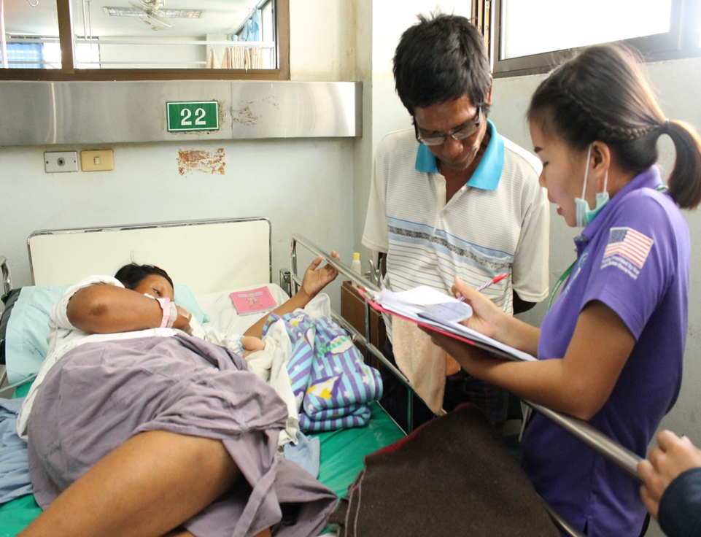
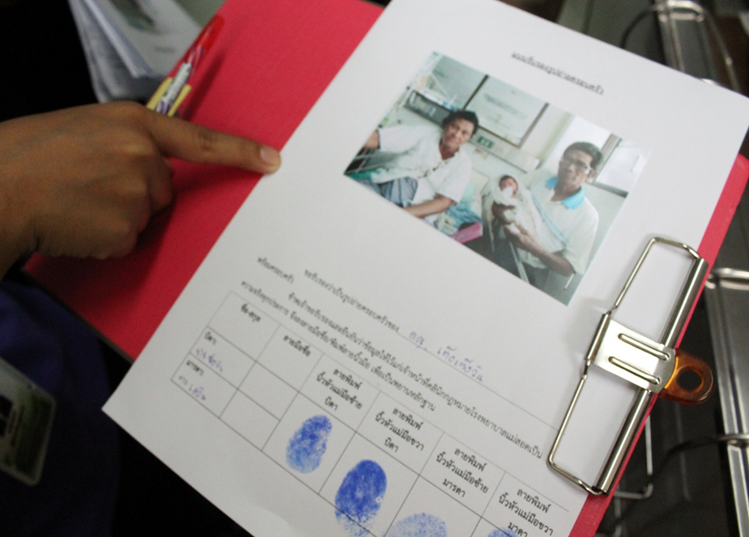
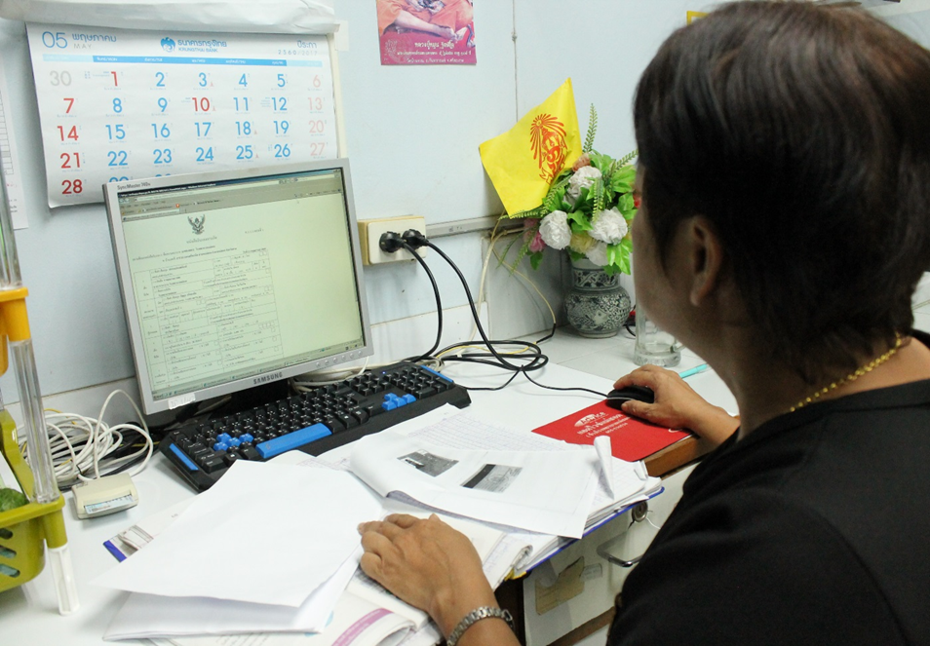
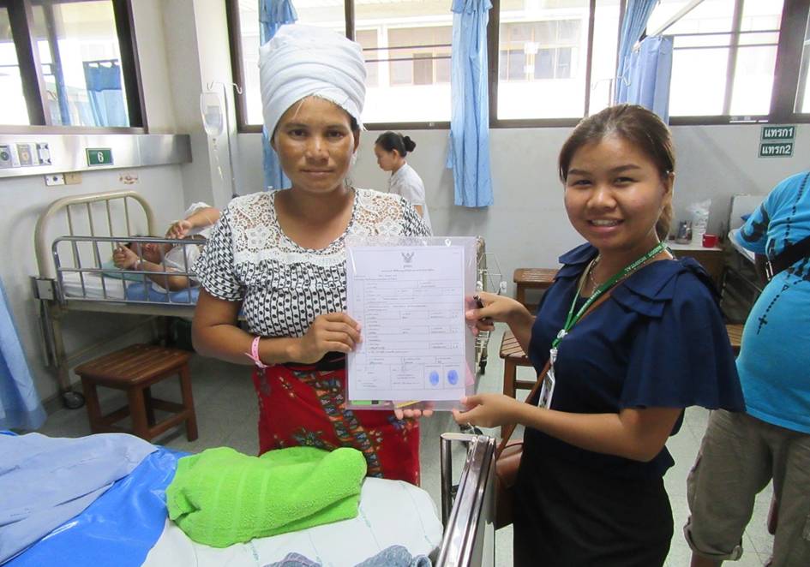
Legal clinic in a hospital at Thai-Myanmar boarder
BORA, MOPH hospitals, International Office of Migration (IOM) and NGOs, to provide legal advice and translation in hospitals where the births of their children most often take place.

Slide 17
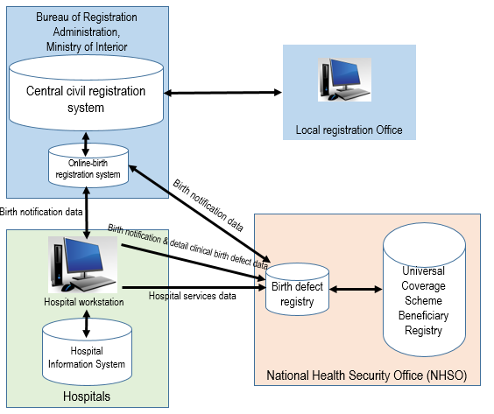
Online birth registration contributes to National Birth Defects Registry

Slide 18
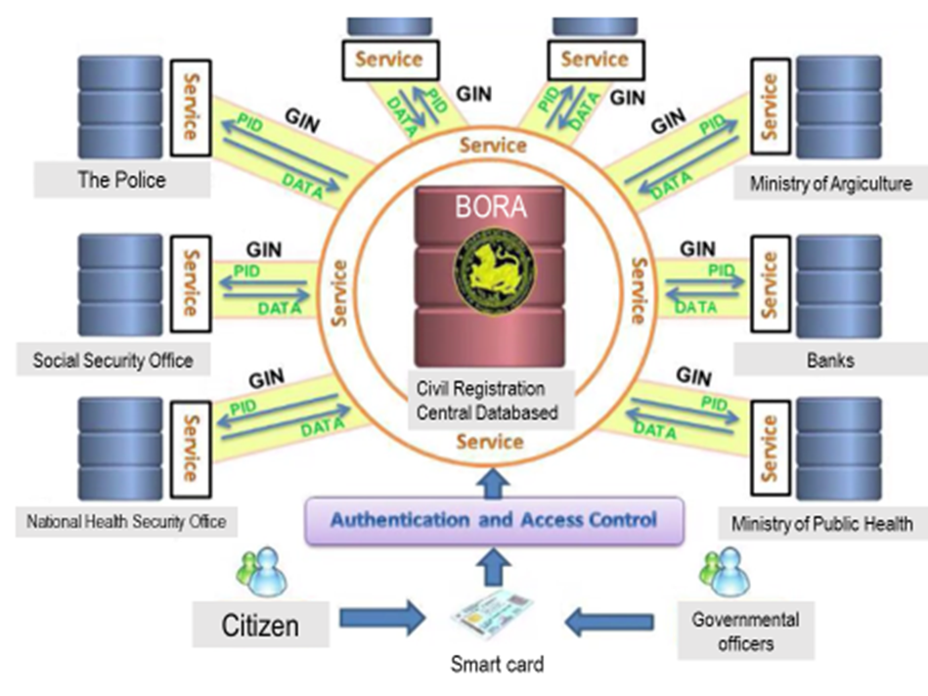
Population Database Integration and Improvement of Government Services, 2015
GIN = Government Internet Network, BORA = Bureau Of Registration Administration

Slide 19
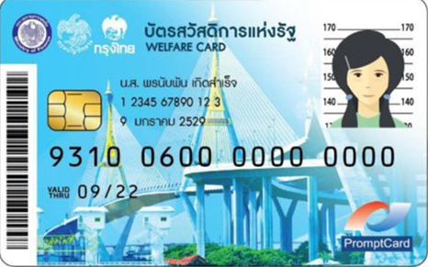
Thailand Welfare Card & Scheme for the Poor
Criteria of the targeted poor individual
  Must be a Thai citizen
  Age from 18-year-old
  Unemployed or yearly income less than 100,000 Baht (around 3,125 US dollar)
  No asset/bank saving or having asset/ bank saving less than 100,000 Baht.
PID and linked information with government offices and the Banks
14.8 M. registered
11.43 M. eligibles

Slide 20
National Digital ID (NDID) Platform
❖ Identity: Who are you ?
  Collections of attributes. Biometrics data, behavior, ancestors and etc.
❖ Authentication: Proof that you are who you say you are.

