Slide 1

Protection and preservation of civil registration record and data and the role of digitisation
Gloria Mathenge
14th Nov 2018

Slide 2
Introduction
In 2017, the Brisbane Accord Group (BAG) led by Pacific Civil Registrars Network (PCRN) hosted a regional workshop focussed on supporting civil Registries in the Pacific in building systems that are resilient to disasters
Record management and in particular risks associated with handling and overall management of old paper and the data held on this records was one of the key emerging themes:
In Oct 2018, BAG supported by PCRN, PABIRCA, the National Archives of Fiji and the National Archives of New Zealand held a follow up workshop on record management

Slide 3
Background
Most registries face a risk of loss of records and/or fraudulent manipulation of civil registration records and data.
Loss of records can occur in various forms including due to:
  Record deterioration leading to illegibility of records
  Physical loss of records including due to disasters
  Risks posed by staff record management practices e.g. Unauthorised access, data sharing, record amendment etc.
Impact of such loss or fraudulent records could be significant. Record loss erodes a country of its history. Fraudulent manipulation of records could easily lead to insecurity at a national and regional level, and overall mistrust of the registry by the public and government.

Slide 4
Background
Record management training for registrars on preventive conservation, handling of records, storage of records, covering both paper and electronic registers is critical
The UN handbook and guidelines do provide some level of guidance on management of registration processes and documents. These however could best strengthened

Slide 5
Regional context (Pacific)
A number of countries operate on manual systems with paper as the main format of record keeping for the legal record and the data
    There are important perceived benefits of using paper as a major format of record keeping for the region, while also appreciating important risks associated with it
Example country x:
  Fire incident that affected the BDM office and hospital records office & pharmacy in 2013)
  An IT system was procured by the government but collapsed in 2013 and switched off.
  There were attempts to retrieve data from the server but this failed, primarily its hardware failure not a software problem. Budget constraints to pay additional special maintenance fee.

Slide 6
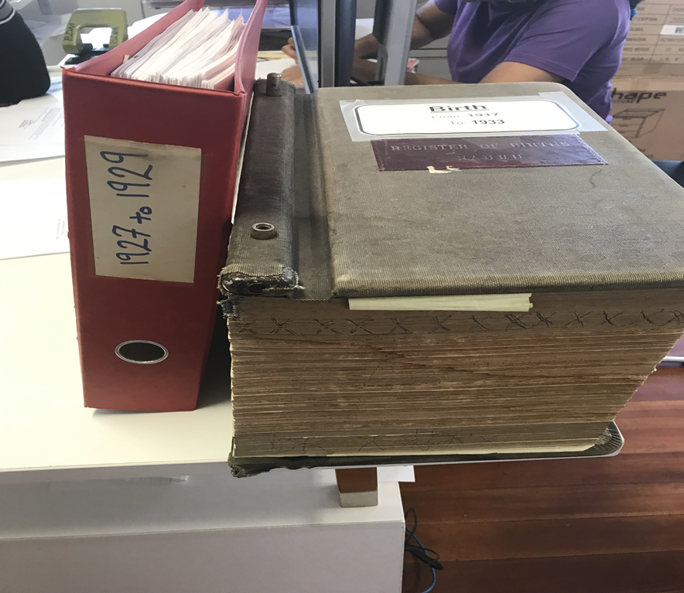
Regional context …
2. Even for countries that have moved to digital systems, handling of paper records is still a day to day
    Old paper registers which are linked to important rights to ownership of land, confirmation of family relationships and identity and these though old are routinely referenced.
    Question: How does a country build security and preserve this very critical national resource from the daily risks of wear, tear, theft etc?

Slide 7
In addressing these key issues, the workshop sought to provide guidance on :
Important record management practices “house-keeping rules” for civil registration officials and how these impact on the authenticity, reliability and longevity of civil registration records and data.
Preliminary training/ an overview of how to preserve and conserve paper records
The role of IT in record management: Understanding the key benefits, risks and how to mitigate them

Slide 8
Record life cycle and key considerations to make while dealing with records at different stages
Pre-record creation
Controlled access to New registers/ forms and certificates
Record creation
Assurance of confidentiality to registrants and its impact on data quality
Staff practices (record etiquette)
Record maintanance
Routine back up
Sharing of data for statistical purposes
Paper security
Numbering and filing of records
Sharing or records with other government departments
Good documentation practices:
Modification/ amendment of records
Safe storage, protection from loss, theft, physical damage
Data integrity i.e. consistency, completeness, accuracy
Ensuring records are Attributable-use of signatures, personal seals, user log ins for electronic documents,

Slide 9

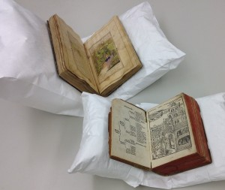
Good practices for maintenance of frequently referenced files
Recordkeeping for
Good Governance Toolkit
GUIDELINE 1:
Recordkeeping Capacity Checklist
Type and quality of paper
Type of Storage facilities-having a dedicated storage room
  Recommended temperature and humidity levels
  Pest and rodent control
Shelving, packaging and labelling of records, file numbering
Record security-access control
Protection against theft and tempering
Handling of records:
  Always handle with care especially where paper are oversized fragile (book cradles
  Never allow food or drink near items
  Use a rigid support, such as piece of cardboard when carrying papers

Slide 10
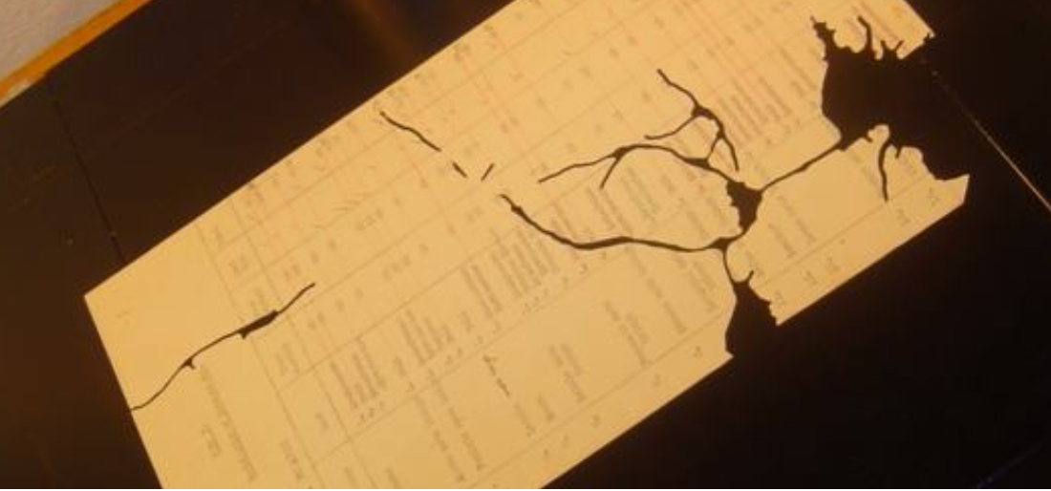
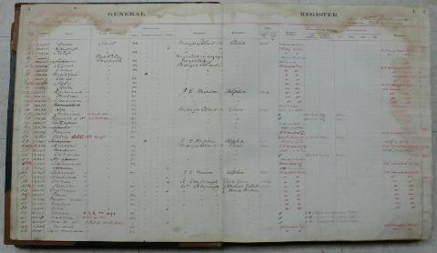
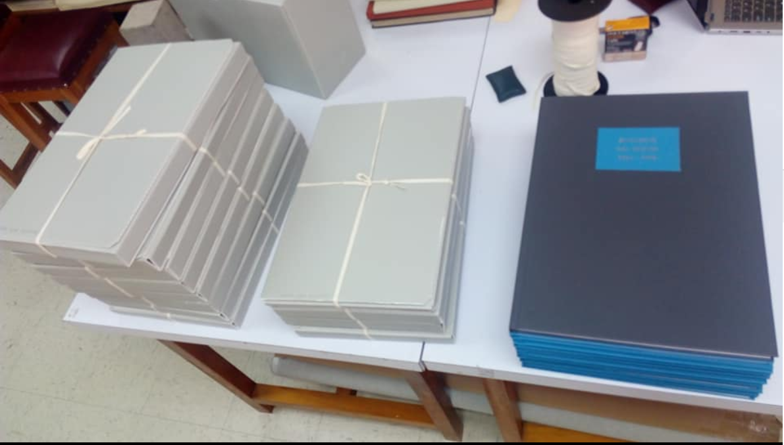
Fiji’s support to Tuvalu
In 2017 Fiji National archives supported the Tuvalu civil registry in the conservation and digitisation of their records
From fragile records that were at risk of permanent damage to copies that are expected to last another 100 years
  Scanning of records, cleaning of records, editing of records
Use of acid free boxes for storage

Slide 11
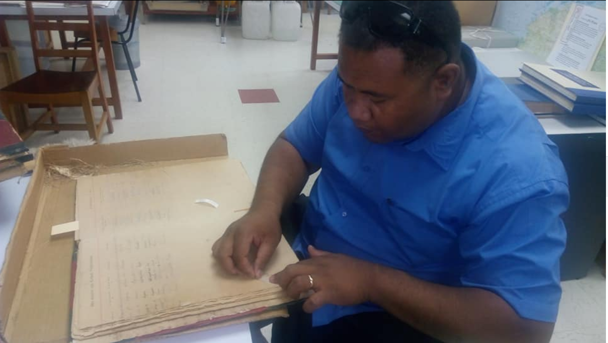
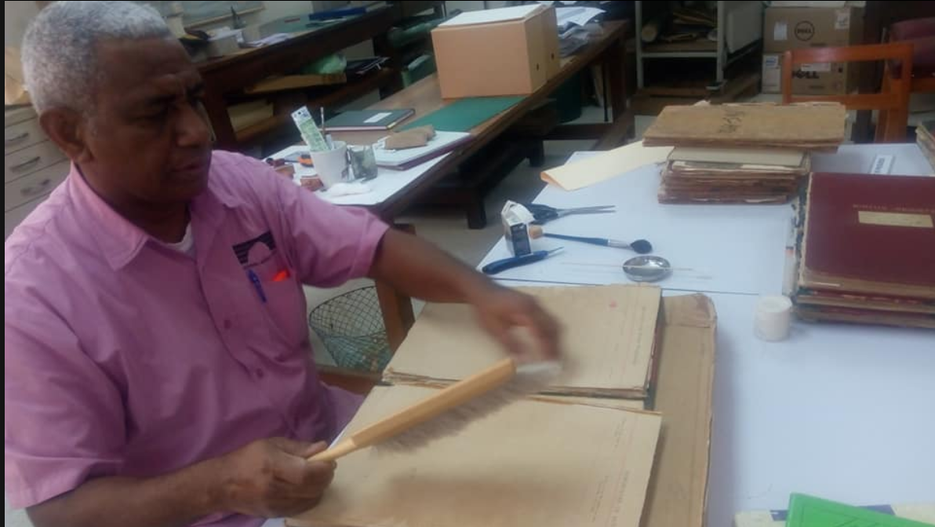
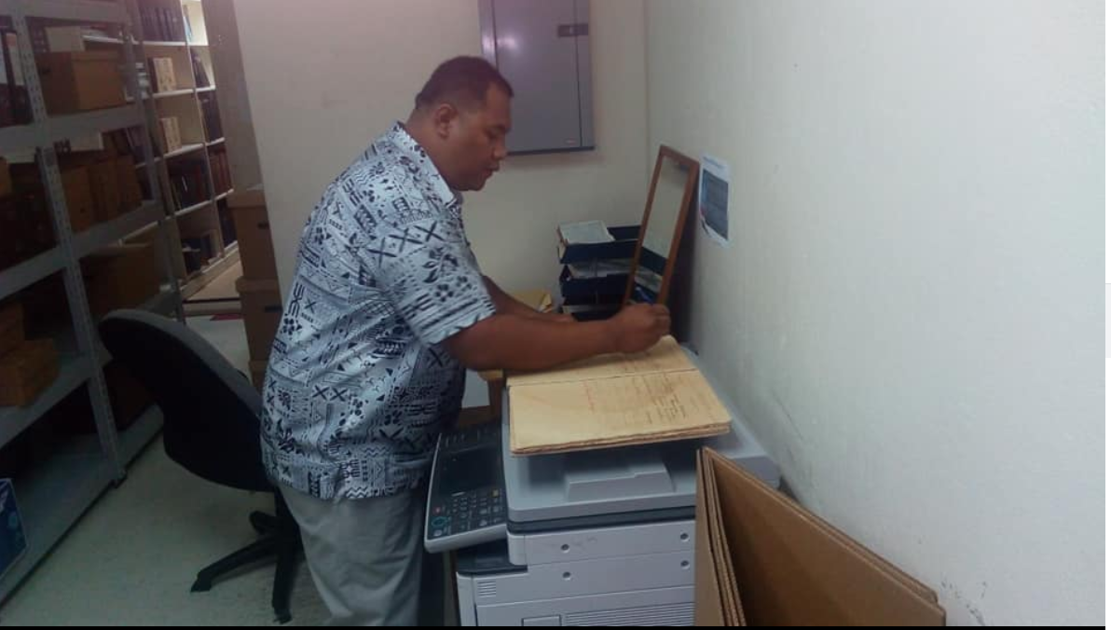
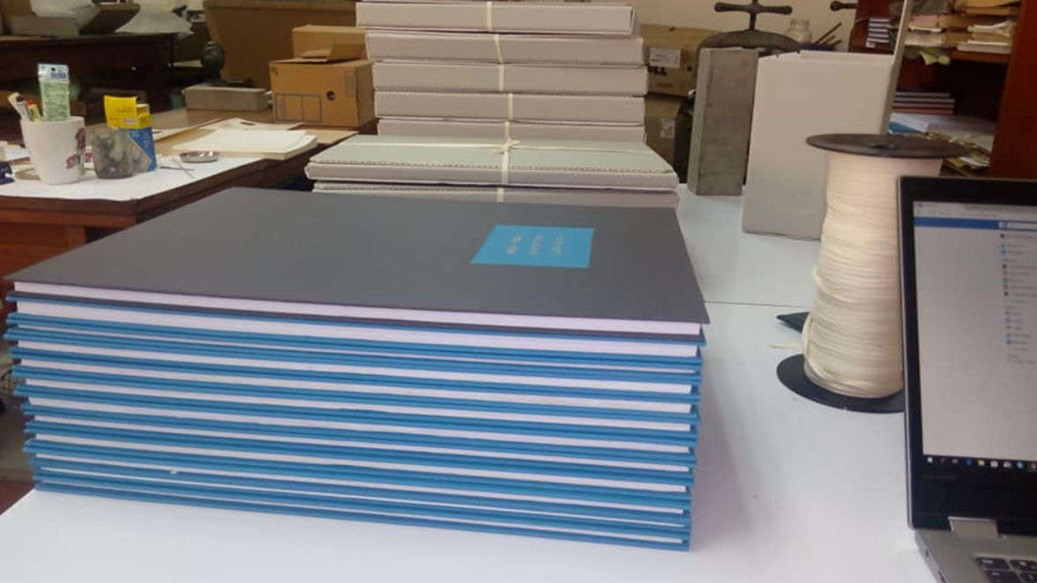

Slide 12
Key message from the exercise
Use of old paper records requires creation of working copies of records rather than continual use of original record as this increases risk of permanent damage
As we create new records and move to electronic versions, we should care about preserving what exists
It is critical that all old and current records are digitised, with proper indexing:
  How do address this as a recurrent challenge in country?
  Storage of paper is expensive, paper digitisation projects are expensive and most countries cannot routinely address this [viewed as lesser important component of the CRVS budget]

Slide 13
Conversion of paper records to electronic form
IT systems offer many advantages for managing records
  Digitising paper records can save storage costs and space, reduce retrieval time, increase security and protect against decay
  Need to have the right metadata and context – maybe index info
  The desire now is to ensure all records are in electronic form
  This means online systems that capture data electronically at source
  Any paper records are scanned and then discarded
  Need to address concerns about loss of information and backup

Slide 14
Risks of not going electronic
Inability to provide access to critical documents quickly and easily
Too easy to lose or misplace paper documents
Business critical information not accessible for the conduct of business, dispute resolution, legal challenge or evidential purposes
Inconsistent and inefficient conduct of business
Reduced capability of demonstrating good performance and any increased efficiencies or improved service delivery

Slide 15
Benefits of going electronic
improved security of business records
detailed metadata (data about the data) can be automatically collected
the ability to deliver services in an efficient and consistent manner
reduced risk of data loss or accidental destruction of records
protection and support in litigation
increased public and/or client confidence
identification of vital records for disaster planning

Slide 16
Risks of going electronic
Records online can be accessed from Internet
In spite of all security provisions they are at risk
People will look to hack into systems, to plant viruses, and social engineer access
Documents can be easily sent to other parties

Slide 17
Reflection
The role of other stakeholders (Archives) in supporting civil registration work in country?
Possibility of updating and expanding UN guidelines on principles and protocols for archival and release of CR records
Should we continue creating more paper? What is the recommendation around this?

