Slide 1


Civil Registration And Vital Statistics System-INDIA
Manoj Kumar
Deputy Registrar General
Office Of The Registrar General, India

Slide 2
CIVIL REGISTRATION SYSTEM
DEFINITION: A continuous, permanent and compulsory recording
of the occurrence and characteristics of vital events
BIRTH, DEATH, STILL BIRTH
MARRIAGE, SEPRATION, DIVORCE,
ADOPTION
ESSENTIAL FEATURES
Universal
Compulsory
Continuous
Permanent
In India
BIRTH, DEATH, STILL BIRTH

Slide 3
Registration Hierarchy
Functions
Central Authority to Coordinate and unify the activities of Chief Registrars and provide general directions.
Registrar General, India
Chief Registrar (States)
District Registrar
Registrars
Implementing the provisions of RBD Act and Rules and securing an efficient system of registration in the respective State
Supervision the registration of births and deaths work in the District and executing the provisions of the Act & order of Chief Registrar.
Registration of births and deaths took place in his jurisdiction and submission of statistical Information

Slide 4
Registration functionaries
Chief Registrar belongs to various departments in States and Union Territories (UT)
Health Department
Planning, Economics & Statistics Deptt-
22 States/UTs
12 States /UTs
Panchayat, Local Administration & Revenue
3 States/UTs

Slide 5
Registration Load (2016)
Registration centers
Rural 2,68,058
Estimated of deaths per year-
8.1 million
Estimated births per year
25.9 million
Urban 6,898
level of Registration
LOR (birth) 86.0%
LOR (death) 78.1%
Level of Reporting
Rural 93.1%
Urban 96.3%
Total 93.3%
Total 2,74,956

Slide 6
CIVIL REGISTRATION SYSTEM
Registration of Births and Deaths
Under a Central Act “Registration of Birth and Death Act (RBD),1969”.
Mandatory and uniform throughout the country
Implementation is the responsibility of the State Governments through State Rules
Registration to be done at the place of occurrence of the event
Provides a legal document for the general public – birth /death certificates

Slide 7
The importance of CRVS
HEALTH PLANNING
Identifying Priorities – NCD’s / Maternal and Child health
GOVERNMENT SERVICES
LAND RIGHTS and INHERITANCE
Targeting Health Programs – Populations at risk
Service Delivery - Immunisations / Population s / Midwives etc
IDENTITY AND SECURITY
Disaster Planning (populations at risk and follow up)
Electoral Rolls
Passports
Education – planning for number and location of teachers, enrolment ratios .
Social Security
Vital Statistics

Slide 8


Civil Registration System
Based on informant reporting structure –
Home events - Head of Household and others
Institutional events - Institutional heads or any official
authorized by them
Others (such as public places) - Headman/police officer in charge of the area

Slide 9
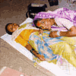


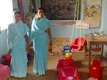
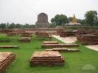
Notifiers
The person who notifies to the Registrar , the event of birth/death at which he/she attended
 | Dai who attended or was present, or event occurred in his/her area of jurisdiction
 | Auxiliary Nurse Midwife (ANM) / Lady Health Visitor (LHV) who attended or was present, or the event occurred in his/her area of jurisdiction
 | Accredited Social Health Activist (ASHA), Health worker who attended or was present, or the event occurred in his/her area of jurisdiction
 | Anganwadi Worker (AWW) who attended or was present, or the event occurred in his/her area of jurisdiction
 | Person-in-charge (of the place where dead bodies are kept) (Caretaker of burial and burning grounds) who attended or was present, or the event occurred in his/her area of jurisdiction

Slide 10
Level of Registration
The level of registration, defined as the percentage of registered births/deaths to the births/deaths estimated by using Sample Registration System (SRS) rates, determines the performance level of a State / Union Territory with regard to functioning of civil registration system. In the absence of reliable estimates of number of births and deaths on a year to year basis from any other source, the number of events as revealed from SRS is used to calculate the level of registration.
Level of Registration (LOR) = Number of registered events during the year X 100
Number of estimated events for the year
Number of estimated events = SRS Rate x Mid year population

Slide 11
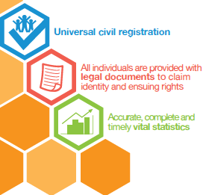
International importance of CRVS
Ministerial Conference on Civil Registration and Vital Statistics System in Asia declared 2015-2024 as CRVS Decade and agreed to regional Action Framework with national targets

Slide 12
Challenges in Registration
Demand side
Lack of awareness on the need and importance of registration.
Non-linking of birth certificates to basic identity
Acceptability of alternate documents such as school certificates, affidavits
Supply side
Lack of coordination among the concerned departments.
Low level of reporting by registration units.
Low priority accorded to the registration work by the Local Registrars

Slide 13



Steps to reach the Goal of 100% Registration
Public awareness and the demand
Capacity strengthening
Cent per cent registration of institutional events
Be aware of your roles and responsibilities
Link benefits to registration of birth/death
Cent percent Registration
Admission
Claims
Service etc.
Registration of all Births and Deaths
Monitoring System for Registration of B&D

Slide 14
Initiatives taken by ORGI
Nationwide database of medical Institutions where births and deaths occur .
Developed Uniform software, for online and offline registration of birth & death .
Developed training manual in 13 languages to assist the registration functionaries.
Computer and related peripherals were provided to all below State level offices.
Enhancement of computerization of CRS- Digitization of old birth and death records.

Slide 15
Computerization of Civil Registration System
Uniform software, for online and offline registration of birth & death and generation of statuary tables.
This s/w is now implemented partly in 29 States/UTs.
This will provide real time data and will track registration activities.
Allows preservation of reporting forms in digital mode.

Slide 16
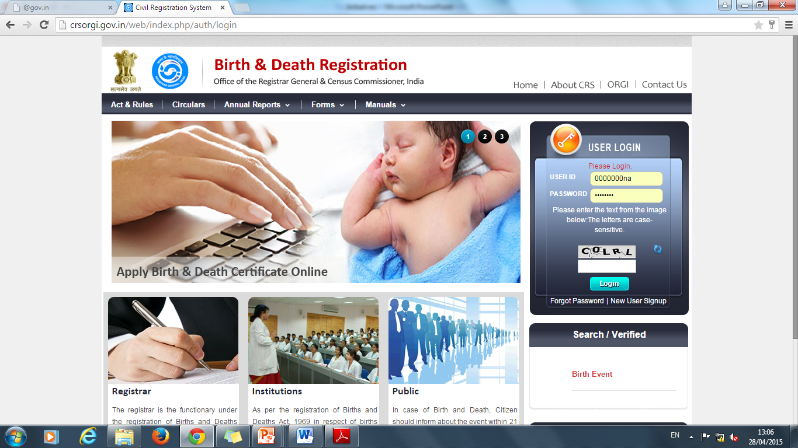

Slide 17
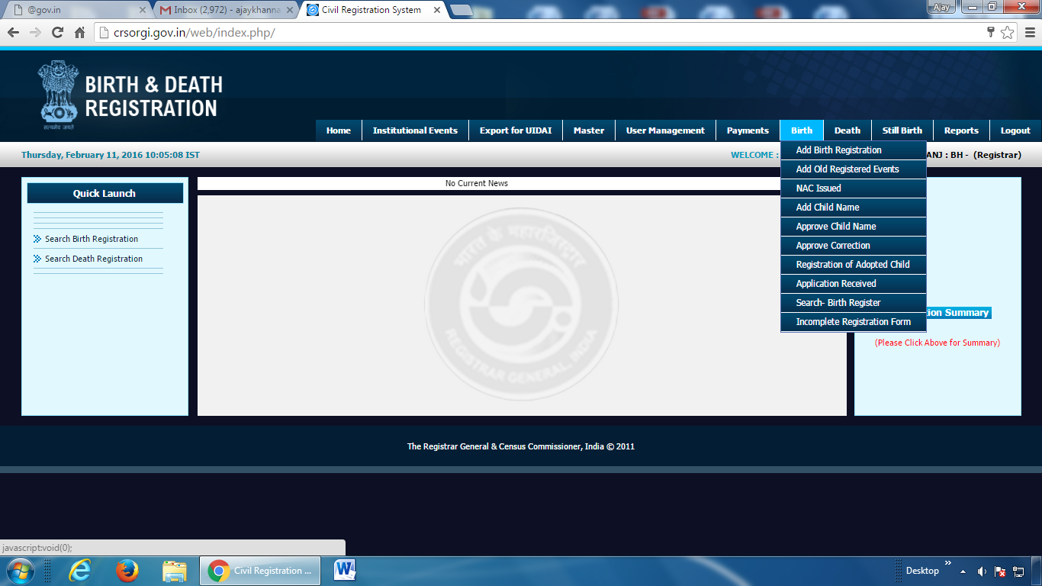

Slide 18
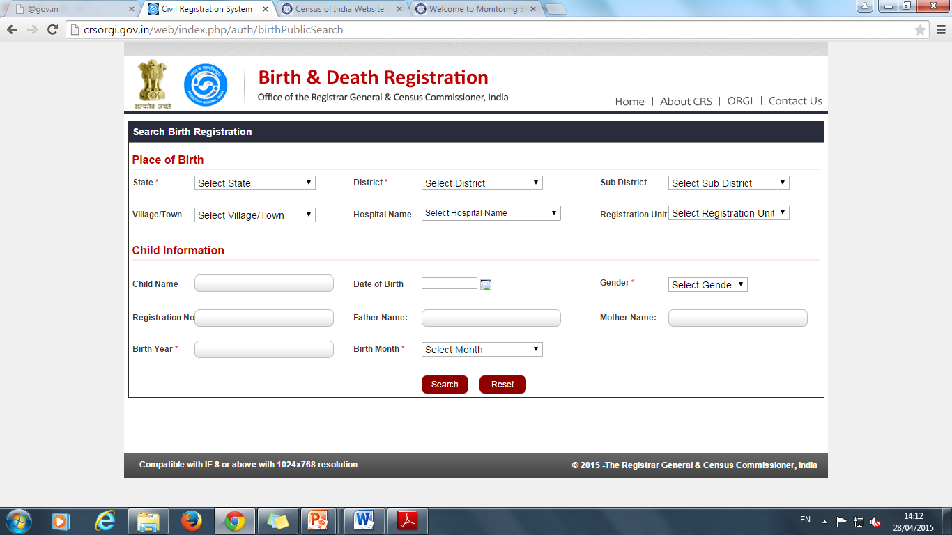
Search Birth registration for public

Slide 19
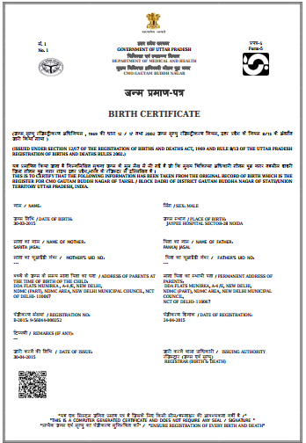
Uniform Certificates across the country
Unique registration no. B-2015: 9-56044-000252
QR code

Slide 20
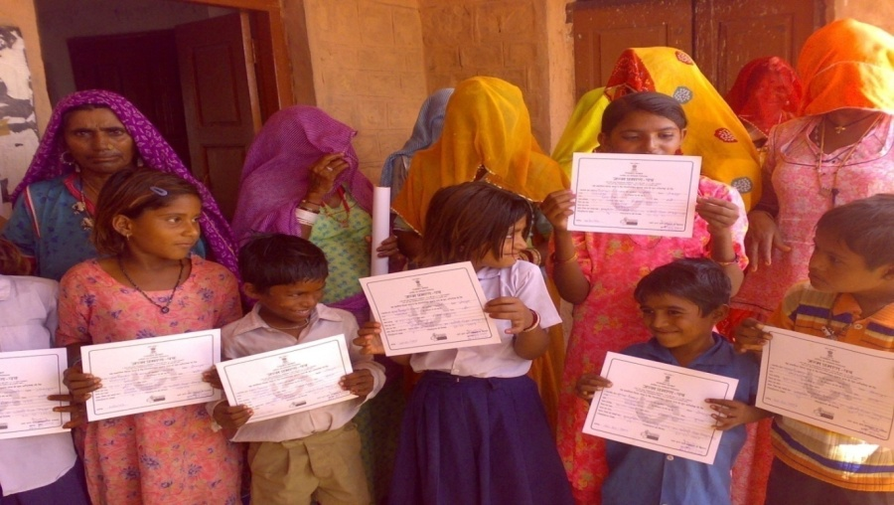
THANKS FOR PATIENCE

