Slide 1
Overview of the CRVS issues and links with the SDGs
Fourth Meeting of the Regional Steering Group
Anir Chowdhury, 14.11.2018

Slide 2
Objectives of the Session
Provide an overview of current CRVS issues
Analyze their relevance for collaboration at the regional level
Discuss possible changes to the RAF and identify possible themes for Ministerial Conference 2020
Notes:
The goal of the session is to see if some CRVS issues that were not that important when the CRVS Decade was declared in 2014 are now requiring more regional collaboration.
Indeed, the SDGs were not adopted when the RAF was designed in 2014. Other issues such as ID systems were less talked about in 2014.
The Ministerial Conference in 2020 is a unique opportunity to get high level support for addressing some of these issues, and can also be used to modify the RAF or CRVS Decade to include new issues.

Slide 3
Overview of current CRVS issues to be covered in Session 3
Sustainable Development Goals
Legal identity
Identity management
Digitization
Access to registration for hard to reach populations
Cause of death

Slide 4

17 Goals, 169 Targets, 232 Indicators
Notes:
In 2015 with the end of the 15-year cycle of the Millennium Development Goals (MDGs), the United Nations officially set ambitious goals to banish a whole host of social ills by 2030 by their causes.
The 2030 Agenda for Sustainable Development, adopted by all United Nations Member States provides a shared blueprint for peace and prosperity for people and the planet, now and into the future.
At its heart are the 17 Sustainable Development Goals (SDGs), which are an urgent call for action by all countries - developed and developing - in a global partnership. They recognize that ending poverty and other deprivations must go hand-in-hand with strategies that improve health and education, reduce inequality, and spur economic growth – all while tackling climate change and working to preserve our oceans and forests.
Point out that the Regional Action Framework was set up in 2014 before the 2030 agenda.

Slide 5
Sustainable Development Goal 16:
Target 16.9
“By 2030, provide legal identity for all, including birth registration"
  Legal identity begins at birth, with biographic information collected through the civil registration system
  Facilitate access to services and enforcements of rights
  Death information collected through civil registration is also crucial for a functioning national ID system
  CRVS+ (registration, ID and statistics)
Indicator 16.9.1 “Proportion of children under 5 years of age whose births have been registered with a civil authority, by age”
Notes:
Targets 16.9 and 17.19 specially focused on CRVS.
Goal 16: Promote just, peaceful and inclusive societies
importance of civil registration for gaining access to justice, to health services, immunization and education, and for people to exercise their rights and duties in society
Specifically:
Target 16.9: “By 2030, provide legal identity for all, including birth registration"
Indicator 16.9.1: measures birth registration (under 5 and under 1) –prerequisite and first step towards obtaining a legal identity
Providing legal identity comes with the challenge of managing these.
Modern solutions offer the opportunities and risks for countries to build strong identification systems at scale that was not previously achievable with paper-based approaches. And how can these be protected digital and analog data.
Technological innovations such as biometrics and mobile can offer low-cost solutions for unique enrollment and authentication in remote and rural areas.
Indicator 16.9.1 is very close to RAF Target 1B, which says “By 2024, at least … per cent of children under 5 years old in the territory and jurisdiction have had their birth registered. ”

Slide 6
Sustainable Development Goal 17:
Indicator 17.19.2(b):
“Proportion of countries that
  (a) have conducted at least one population and housing census in the last 10 years; and
  (b) have achieved 100 per cent birth registration and 80 per cent death registration”
Notes:
Goal 17, which highlights the need for revitalizing global partnerships for sustainable development with a focus on capacity building for improved data, monitoring and accountability.
Target 17.19: “by 2030, build on existing initiatives to develop measurements of progress on sustainable development that complement GDP, and support statistical capacity building in developing countries”
Indicator 17.19.2(b): Proportion of countries that have achieved 100 per cent birth registration and 80 per cent death registration
Mention Connection to RAF and the need for high level support to accelerate this progress made so far.

Slide 7
CRVS and SDGs
Health
3.1: Maternal mortality
3.2: Child mortality
3.4: NCD mortality
3.8: Univ. Health Coverage
…
Education
4.1: Univ. primary & secondary edu
4.2: Pre-primary
4.4: Skills and decent jobs
…
CRVS
Identity
Rights
Planning
Coordination
Gender
5.1: Gender parity
5.3: Early marriage
5.a: Asset ownership
…
Inequality
10.1: Accelerate income growth of the bottom 40%
10.7: Safe migration
…
Infrastructure and Innovation
9.b: Domestic R&D
9.c: ICT-supported innovations
…
Sustainable economic growth
8.3: Job creation
8.5: Inclusive decent jobs
…

Slide 8
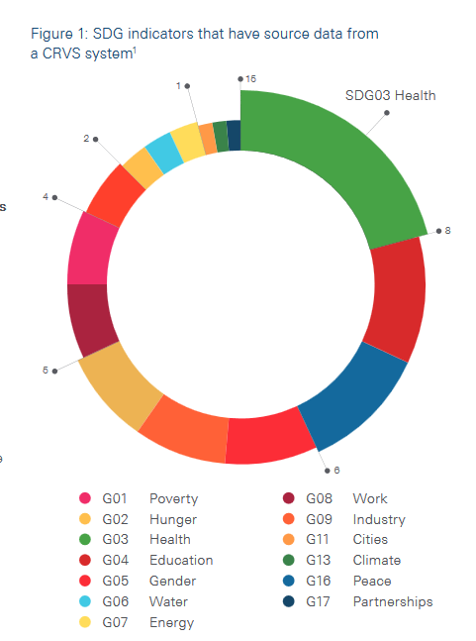




CRVS and SDGs
Figure: SDG indicators sourced from a CRVS system
Well-functioning CRVS systems are:
Essential for planning and implementing SDGs related to social inclusion, health, education, good governance, etc.
Best source for continuous and timely data to monitor SDGs related to maternal mortality, NCD related deaths, etc.
Source of 72+ of 232 SDG indicators
Source: Data for Health
Notes:
About one-third of the SDG indicators will require data from a CRVS system, primarily in the form of population data as denominators for population-based targets
It is important to mention that well functioning CRVS systems are essential to planning and planning the SDGs
SDG 3, for example, seeks to ensure health and well-being at every stage of life. A number of indicators for this goal will require data
from a CRVS system, including maternal and infant mortality rates, mortality rates due to specific diseases, and the adolescent birth
rate.
Indicator 3.4.1, the mortality rate from cardiovascular disease, cancer, diabetes and chronic respiratory disease, has significant
measurement implications for countries. As does indicator 3.6.1, mortality from road traffic accidents. A functioning CRVS system,
with medical certification and verbal autopsy (where required), is the only source of the cause-specific mortality data
required for monitoring such indicators
CRVS and SDGs:
https://www.getinthepicture.org/sites/default/files/resources/CRVS%20and%20SDGs.pdf

Slide 9
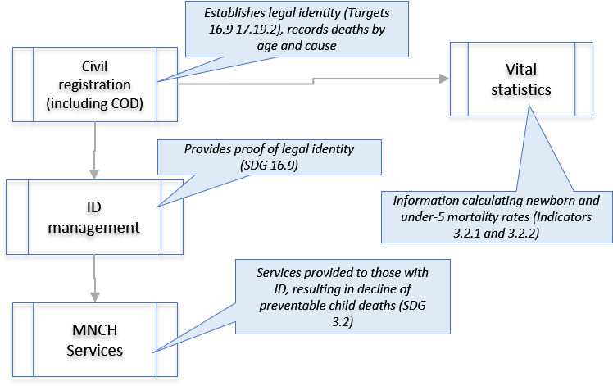
SDG 3.2: Ending preventable deaths to newborns and children under 5

Slide 10
Can we be Ambitious?
Shift Planning from Statistics to Persons
WHO? DROPPED OUT?
Even expand to
Attendance
Exact number of books distribution
Education Database with UID
Health Database
WHY?
DROPPED OUT
Expand statistics to
Nutrition facts vs education quality
Poverty vs education etc.
Poverty Database
SSNP Database

Slide 11
Thinking SDG and CRVS Together
Why should CRVS care?
  Because SDG will make CRVS more meaningful and give it more ‘teeth’
Why should SDG care?
  Because without CRVS, SDG cannot be achieved

Slide 12


Citizen’s Lifecycle with Govt.
BIRTH REGISTRATION
MARRIAGE
REGISTRATION
DEATH
REGISTRATION
MIGRATION
A citizen is coming
The citizen is born
The citizen is immunized
Enrolled in
school
Completes
exams
Becoming a voter
Marrying another citizen
Migration
HEALTH SYSTEM
EDUCATION SYSTEM
SOCIAL SAEFTY NET SERVICES
VOTER ID SYSTEM
CIVIL REGISTRATION: BIRTH, DEATH, CoD,
MARRIAGE, DIVORCE, ADOPTION,
MIGRATION IN/OUT, INTERNAL MOVEMENT

Slide 13
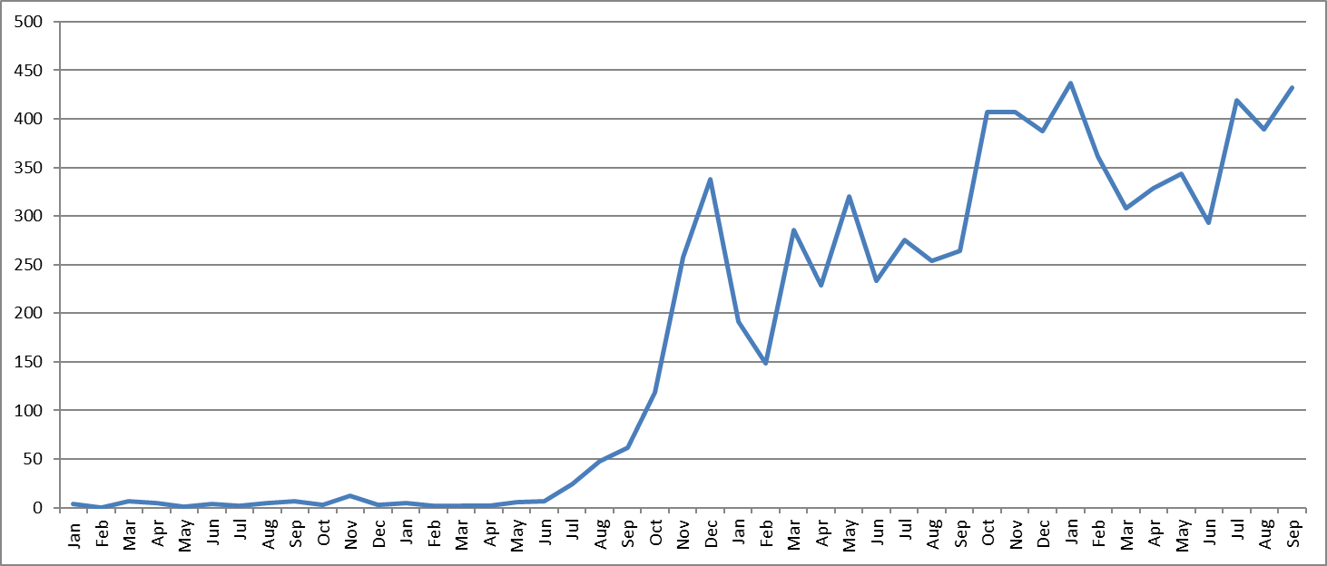
Role of Whole-of-Govt. Coordination to Create Dramatic Improvement
  How?
    Central coordination (creation of CRVS Secretariat at Cabinet Office, and coordination with Office of Registrar General)
    Local coordination (monitoring by local and health administration)
    Data integration across multiple agencies (health worker collecting data and then sending to Civil Registrar)
Registration in 45d | 2016 | 2018
Birth | 1.4% | 95%
Death | <1% | 85%
Scaled up in 13 sub-districts targeting 4 million people

Slide 14
3 Partnerships
South-South and Triangular Cooperation
Whole-of-Government
Political Vision + Bureaucratic Machinery
Must have
Better resource utilization (financial + HR)
Wider ownership
No need to reinvent the wheel
Learning from each other’s mistakes is ‘cheaper’ and ‘smarter’

Slide 15
Thank you!
For more information, please visit: www.getinthepicture.org

