Slide 1
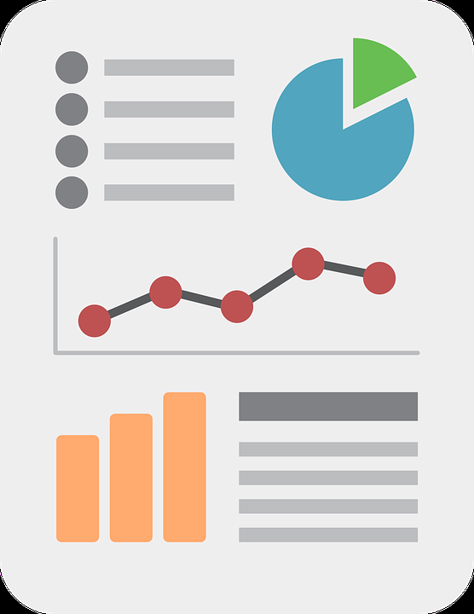
Exemplary Practices for Displaying Public Health Data

Slide 2

Objectives
1
3
Know principles for designing data display solutions
Be able to apply principles to improve solutions
Know generic types of data display solutions
Understand how humans process visual displays
2
4

Slide 3
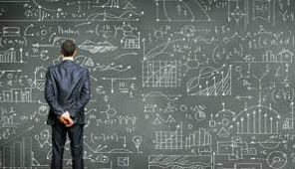
Types of Solutions for Displaying Data
Basic tools used to visually present public health data

Slide 4

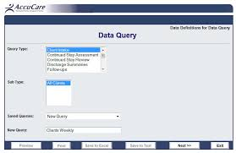
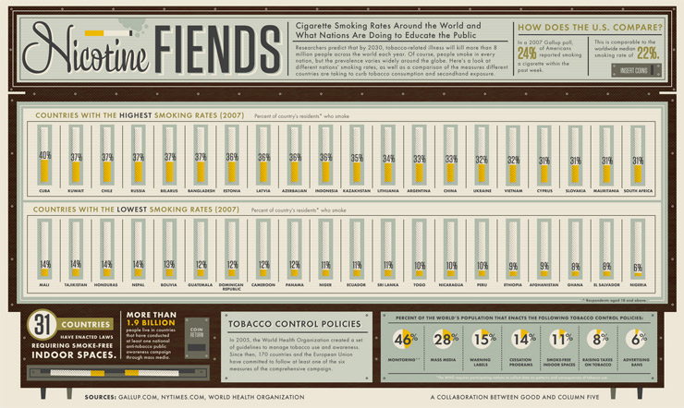
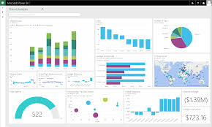
Data Portals
Stand Alone Visualizations
Dashboards
Infographics
Data Display Solutions

Slide 5
LESS COMPLEX MORE COMPLEX
FLOW
STATIC
Stand Alone Visualizations
FILTERING
Infographics
INTER-ACTIVE
Data Access
Portals
Data Story
Portals
Dashboards
FUNCTIONALITY
Data Display Solutions

Slide 6
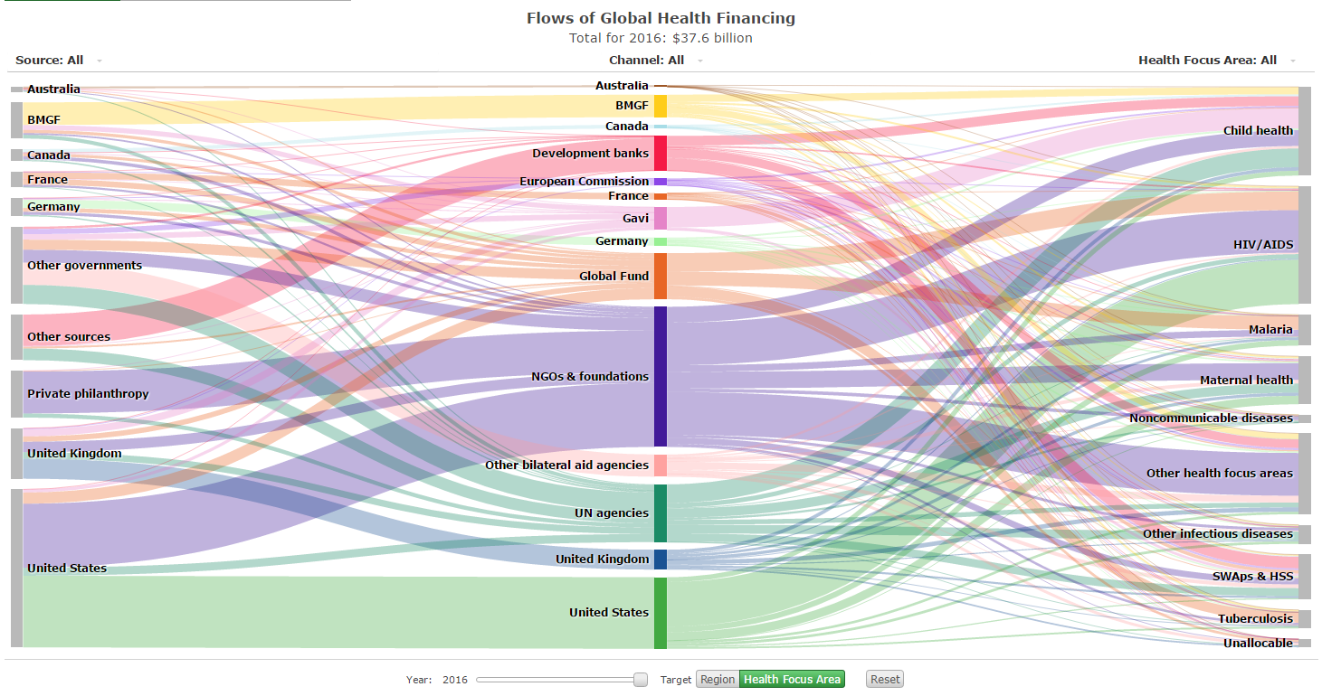
Stand-Alone
Data Visualizations
Communicating data-driven insights with graphics

Slide 7
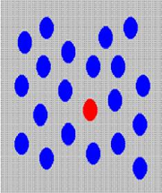
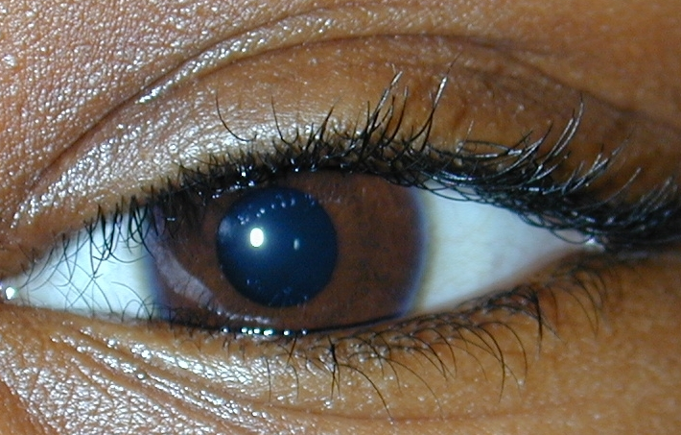
Visual Processing
Understanding how humans see is essential for designing effective data displays

Slide 8


Slide 10

Two Types of
Visual Processing
Top Down
relevant objects
Bottom Up
noticeable features
PATTERNS & MEANING
10

Slide 11
Data Visualization Design:
Principles Based on Top-Down Visual Processing
Align chart type w/ purpose
A chart is a tool you provide to viewers for a specific objective. Don’t give them a screwdriver if you want them to drive in a nail!

Slide 12
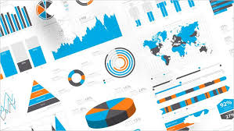
Analytic Purposes
Description
  Distribution
  Composition
Comparison
  By group
  By location
Change over time
Explanation

Slide 13
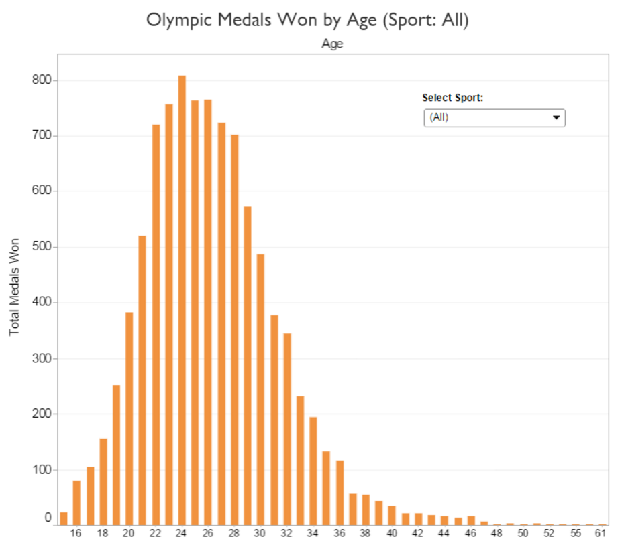
Options for:
DESCRIPTION (Distribution)
Histogram

Slide 14
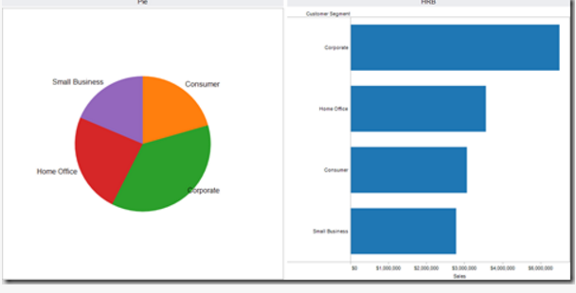
Options for:
DESCRIPTION (Composition)
Pie Chart

Slide 15
Options for:
DESCRIPTION (Composition)
Bar Chart

Slide 16
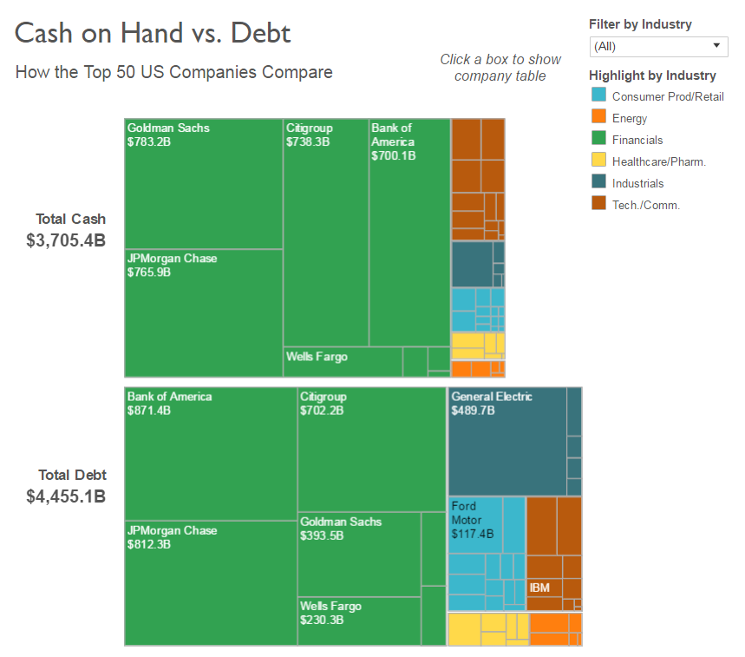
Options for:
DESCRIPTION (Composition)
Tree Map

Slide 17
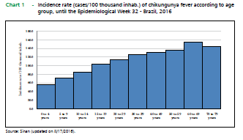
Options for:
COMPARISON
(By Group)
Bar Chart (Vertical)

Slide 18
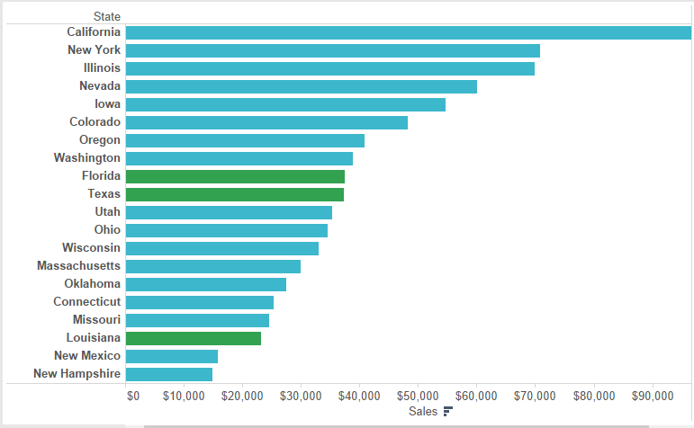
Options for:
COMPARISON
(By Group)
Bar Chart (Horizontal)

Slide 19
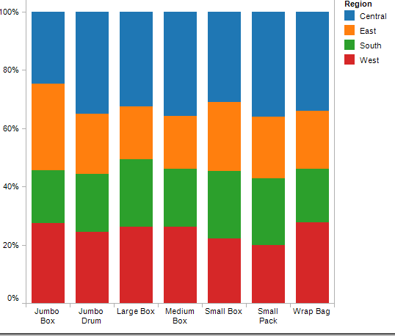
Options for:
COMPARISON + COMPOSITION
Stacked Bar Chart

Slide 20
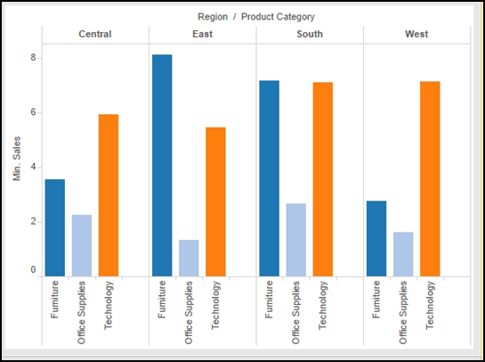
Options for:
COMPARISON
(By Location)
Bar Chart

Slide 21
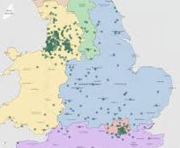
Options for:
COMPARISON
(By Location)
Map (Point)

Slide 22
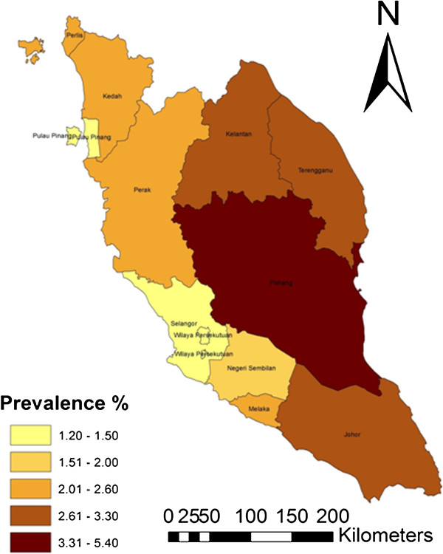
Options for:
COMPARISON
(By Location)
Map (Choropleth)

Slide 23
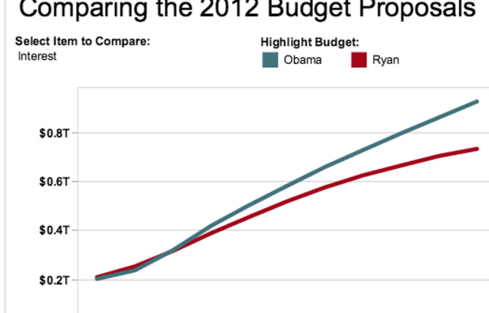
Options for:
CHANGE OVER TIME
Line Chart

Slide 24
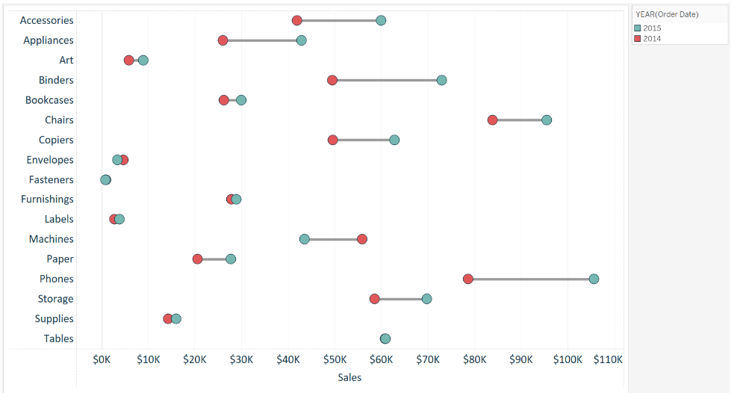
Options for:
CHANGE OVER TIME + COMPARISON
Line Chart
Horizontal

Slide 25
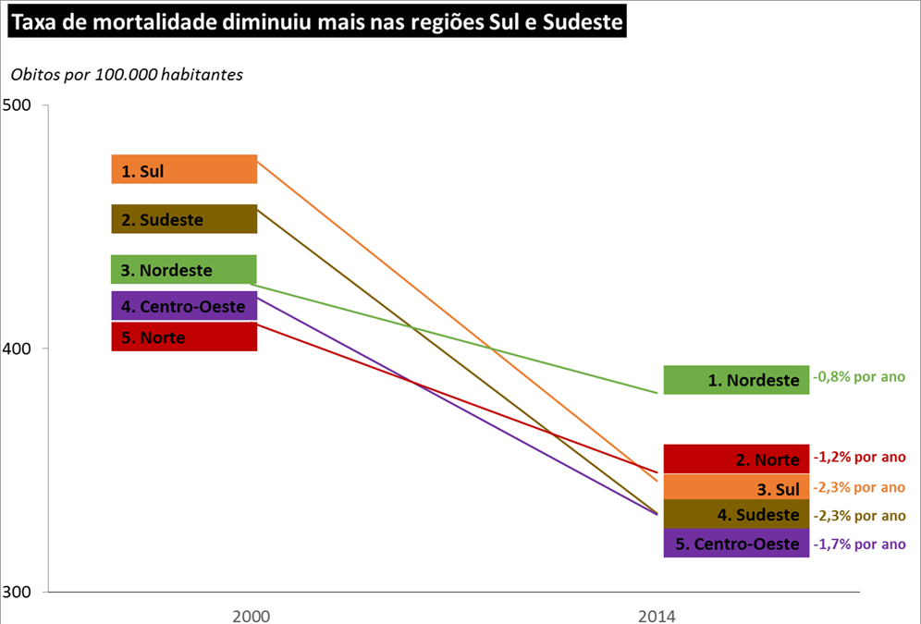
Options for:
CHANGE OVER TIME + COMPARISON
Slope Chart

Slide 26
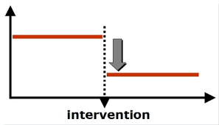
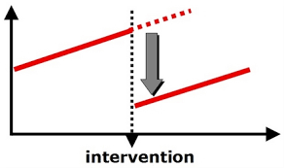
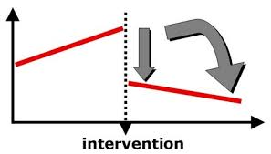
Options for:
EXPLANATION
(Intervention)
Line Charts

Slide 27
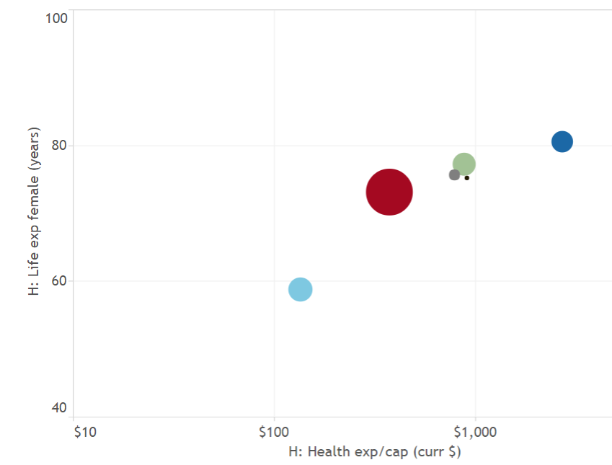
Options for:
EXPLANATION
XY + Bubble Charts

Slide 28
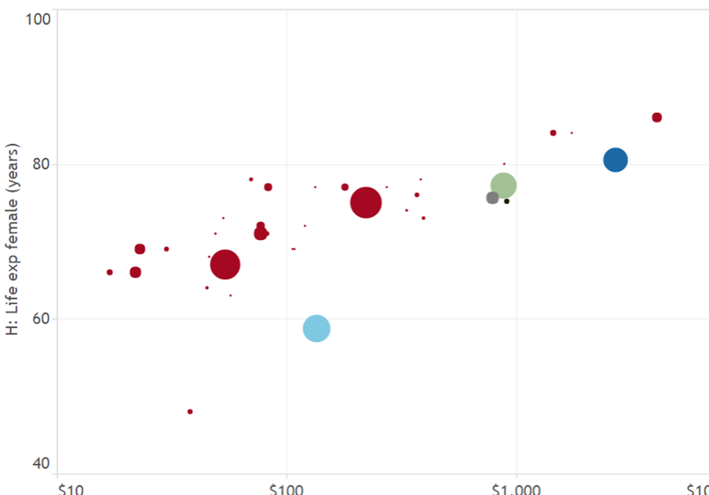
Options for:
EXPLANATION
XY + Bubble Charts

Slide 29
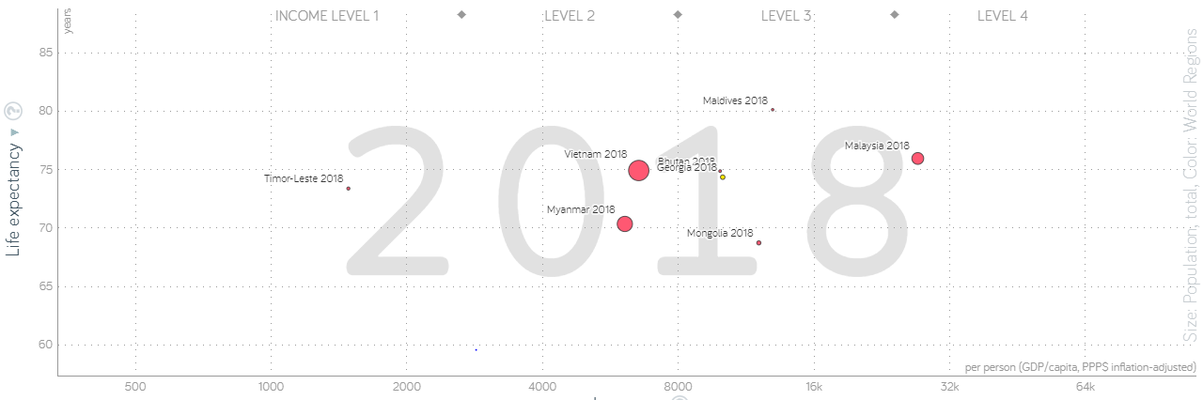

Slide 30
Data Visualization Design:
Principles Based on Top-Down Visual Processing
Align chart type w/ purpose, data
A chart is a tool you provide to viewers for a specific objective. Don’t give them a screwdriver if you want them to drive in a nail!
Display
reference values
Numbers are hard to interpet in a vaccum. Build in benchmarks that help viewers make sense of the data.

Slide 31
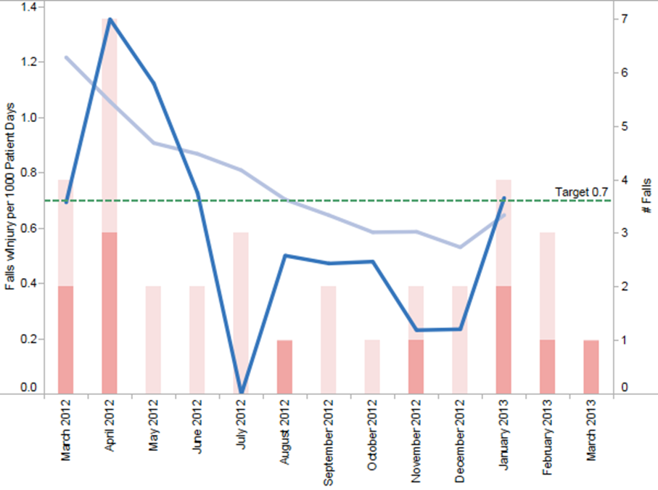
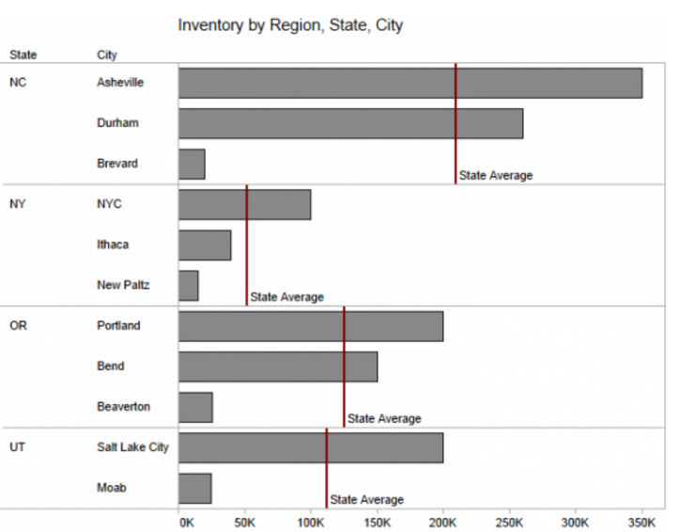
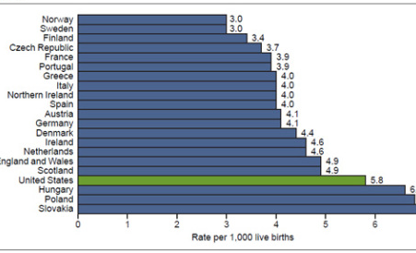
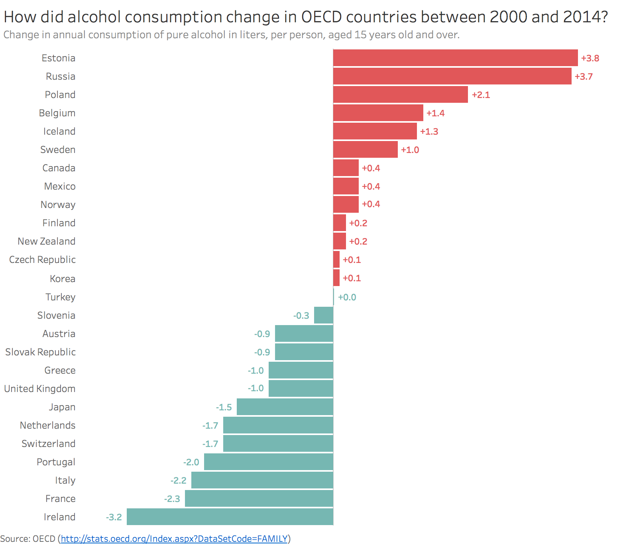
Reference Values
External benchmarks
Internal dataset measures

Slide 32
Reference Values
External benchmarks
goal/target

Slide 33
Reference Values
External benchmarks
international average

Slide 34
Reference Values
External benchmarks
deviation from average

Slide 35
Reference Values
Internal dataset measures
mean

Slide 36
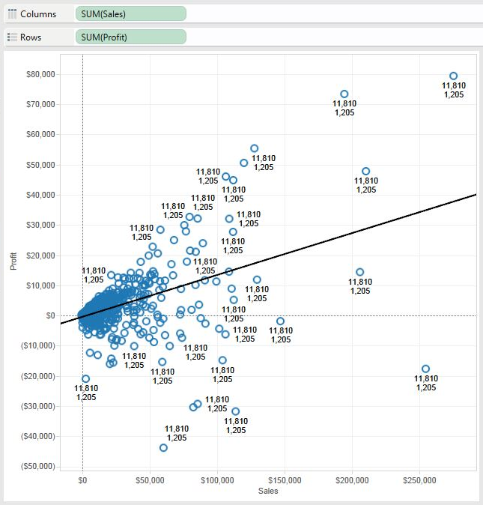
Reference Values
Internal dataset measures
trend

Slide 37
Data Visualization Design:
Principles Based on Bottom-Up Visual Processing
Have a visual hierarchy
Viewers instinctively go toward items whose formatting is high in the hierarchy. Are those items where you want them to focus?
Facilitate scanning
Face it…most viewers will not go over your visualization intensely. So make sure important parts will be seen during scanning.
Remove all clutter
Unnecessary elements distract viewers, even when they are formatted low in the hierarchy. Why not get rid of them entirely?
Use color purposefully
Color can be eye-catching, right? So feel free to use it to grab attention. But make sure it means something.

Slide 38
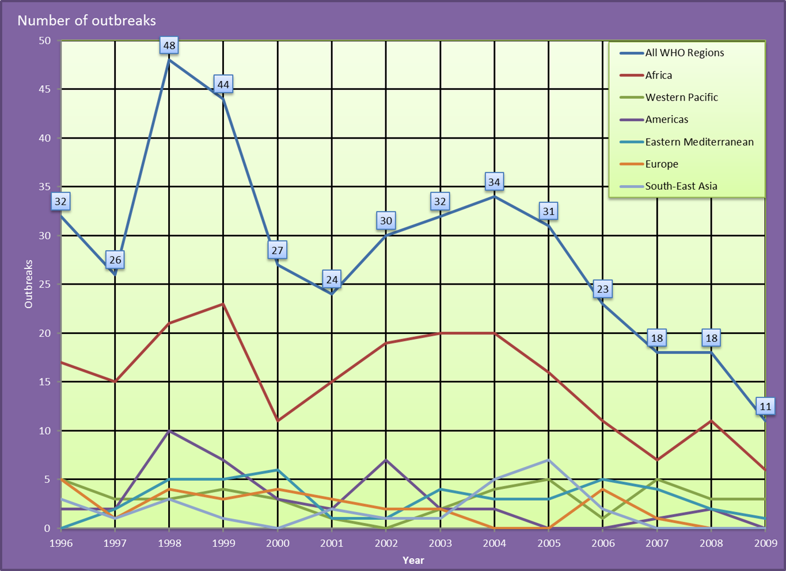

Slide 39
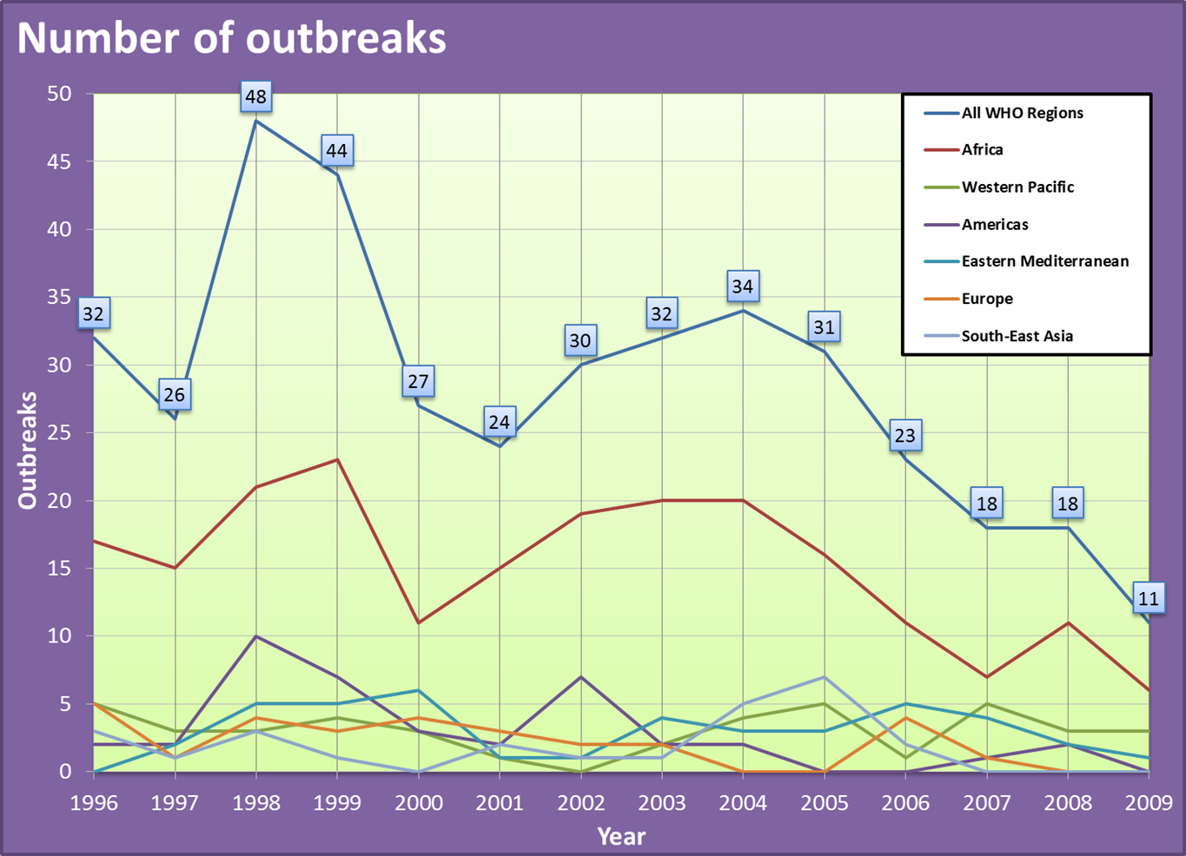

Slide 40
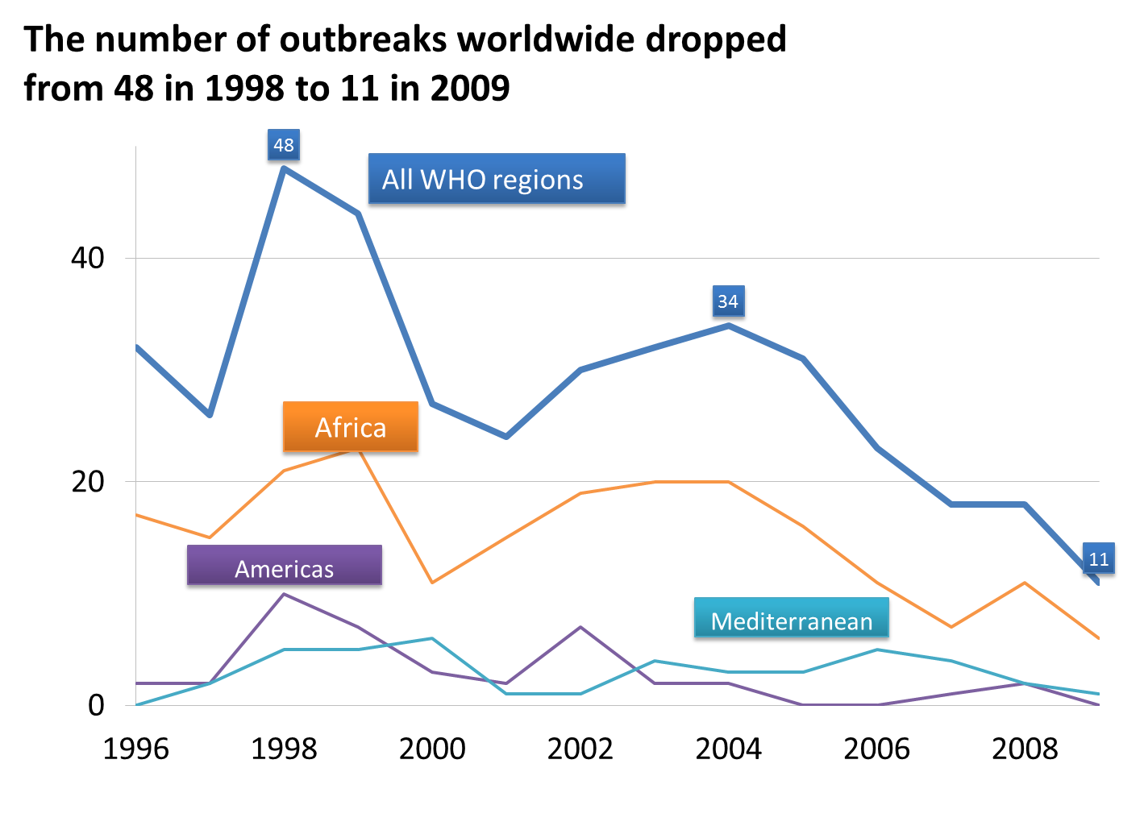

Slide 41

One More Principle:
Promote a consistent experience
Platforms
Do the design choices you made for a print visualization have the same impact online?
Do print visualizations look similar when produced in color and in black and white?
Do online visualizations look similar on desktop/laptops as on mobile devised?
Viewers
Does the visualization best suited for experts? Or will the design also work with non-expert audiences?
Will critical design features not be apparent to color-blind viewers?

