Slide 1


Data-Driven Communication Material

Slide 2

Objectives
1
3
Know traits of effective communication material
Be able to structure effective pitches and presentations
2
Be able to draft accessible data-centered messages

Slide 3

Attributes of Effective Communications Material
How to evaluate whether your speech (or presentation or report or…) is likely to do its job

Slide 4
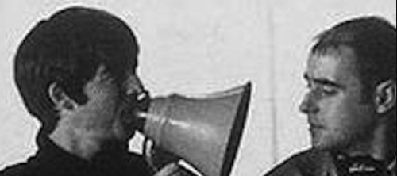
The Seven C’s
Command attention
Clarify messages
Communicate benefits
Cater to heart & head
Be Consistent
Call to action

Slide 5
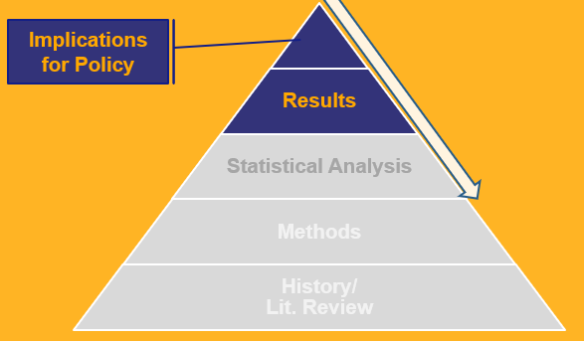
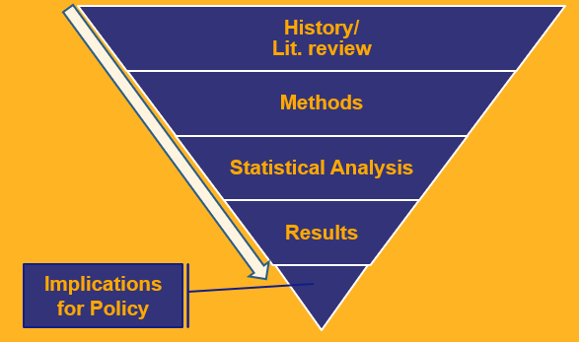
Get to point quickly
Command attention
Clarify messages
Communicate benefits
Cater to heart & head
Be Consistent
Call to action
THIS…
…NOT THIS

Slide 6

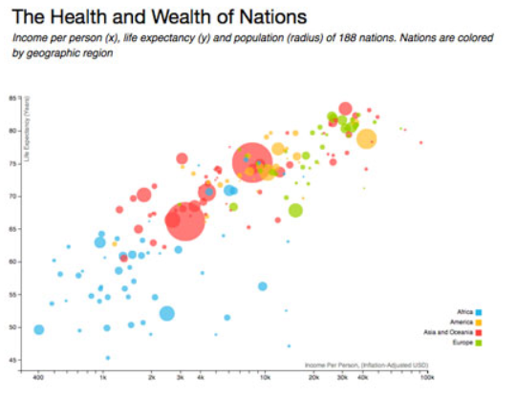

Create interest
Command attention
Clarify messages
Communicate benefits
Cater to heart & head
Be Consistent
Call to action
THIS…
…NOT THIS

Slide 7


Be direct…
Command attention
Clarify messages
Communicate benefits
Cater to heart & head
Be Consistent
Call to action
in words
in numbers

Slide 8


Balance positive and negative messaging
Command attention
Clarify messages
Communicate benefits
Cater to heart & head
Be Consistent
Call to action

Slide 9


Engage before arguing
Command attention
Clarify messages
Communicate benefits
Cater to heart & head
Be Consistent
Call to action

Slide 10
Align different content
Command attention
Clarify messages
Communicate benefits
Cater to heart & head
Be Consistent
Call to action
Messages
Stories
Data

Slide 11


Make an ask
Command attention
Clarify messages
Communicate benefits
Cater to heart & head
Be Consistent
Call to action
Learn More
Do Something

Slide 12
Talking About Data
How do we communicate technical messages to
non-technical audiences

Slide 13



1. Simplify
language
2. Simplify numbers
3. Personalize

Slide 14
Common Terminology
1. Simplify
language
Technical
Mortality
Morbidity
Fertility
Incidence
Prevalence
Non-Technical
Deaths
Illness
Birth
New cases
Total cases

Slide 15

Tips for Expressing
Data Points
2. Simplify
numbers
Limit decimals
Use round numbers
Avoid small numbers (ex. 0.003)
Express uncertainty through ranges

Slide 16
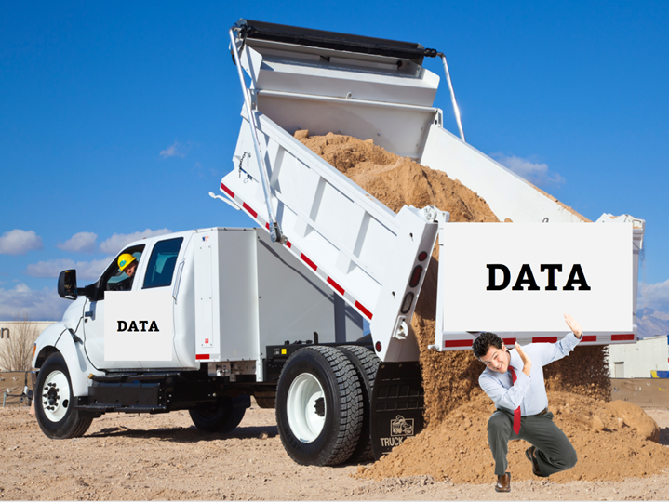
Most countries with a density of skilled health professionals below 22.8/10,000 population and a coverage of births by skilled birth attendants (SBA) below 80% are in Africa (31 countries, 57.4%) and in South‐East Asia (7 countries, 12.9%).
Oman, the Emirates and Saudi Arabia have over 80% dependence on foreign trained health personnel.
A global deficit of 12.9 million health workers is estimated by 2035 against the threshold of 34.5 skilled health professionals per 10,000 people.
In the 100 countries presently below the 34.5/10000 threshold of health workers, there is currently a total shortage of about 7.2 million health workers.

Slide 17
Use analogies
2. Simplify
numbers
Examples:
“the same number as the entire population of CITY”
“last year the total exceeded the amount for previous x years combined”

Slide 18
Sample Plot of a Data Story
2. Simplify
numbers
What we need to do
What will be impact
Where we
could be
Where we are now
Where we were

Slide 19
1. Simplify
language
2. Simplify numbers
3. Personalize

Slide 20
Objectives
1
3
Know traits of effective communication material
Be able to structure effective pitches and presentations
2
Be able to draft accessible data-centered messages

